Slide 1
Early Syphilis (Primary, Secondary, and Early Latent) Epidemiology in North Carolina 2017
November 2018
North Carolina Division of Public Health/Epidemiology Section/Communicable Disease Branch
HIV/STD/Hepatitis Surveillance Unit

Slide 2
Data Source: North Carolina Electronic Disease Surveillance System (data as of June 28, 2018)

Slide 3
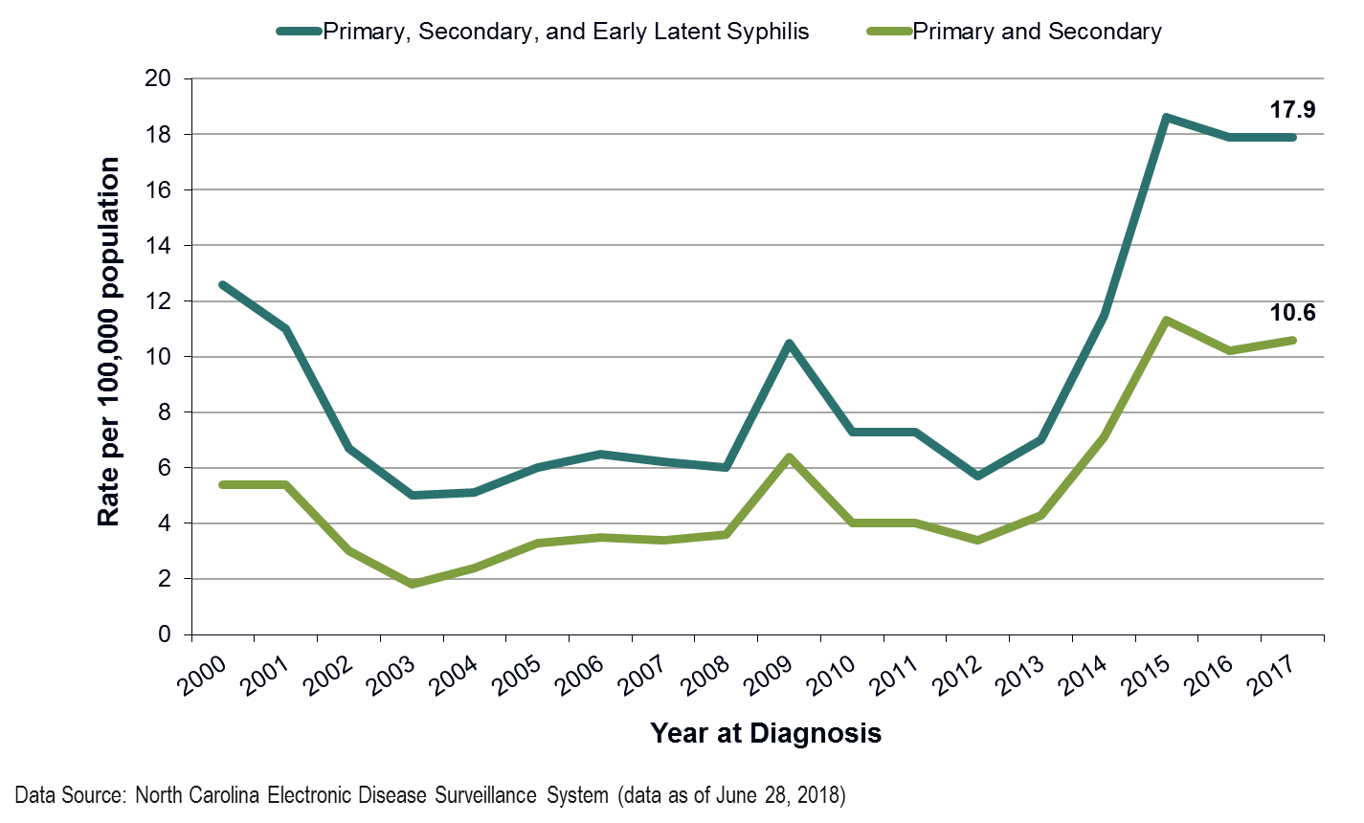

Slide 4
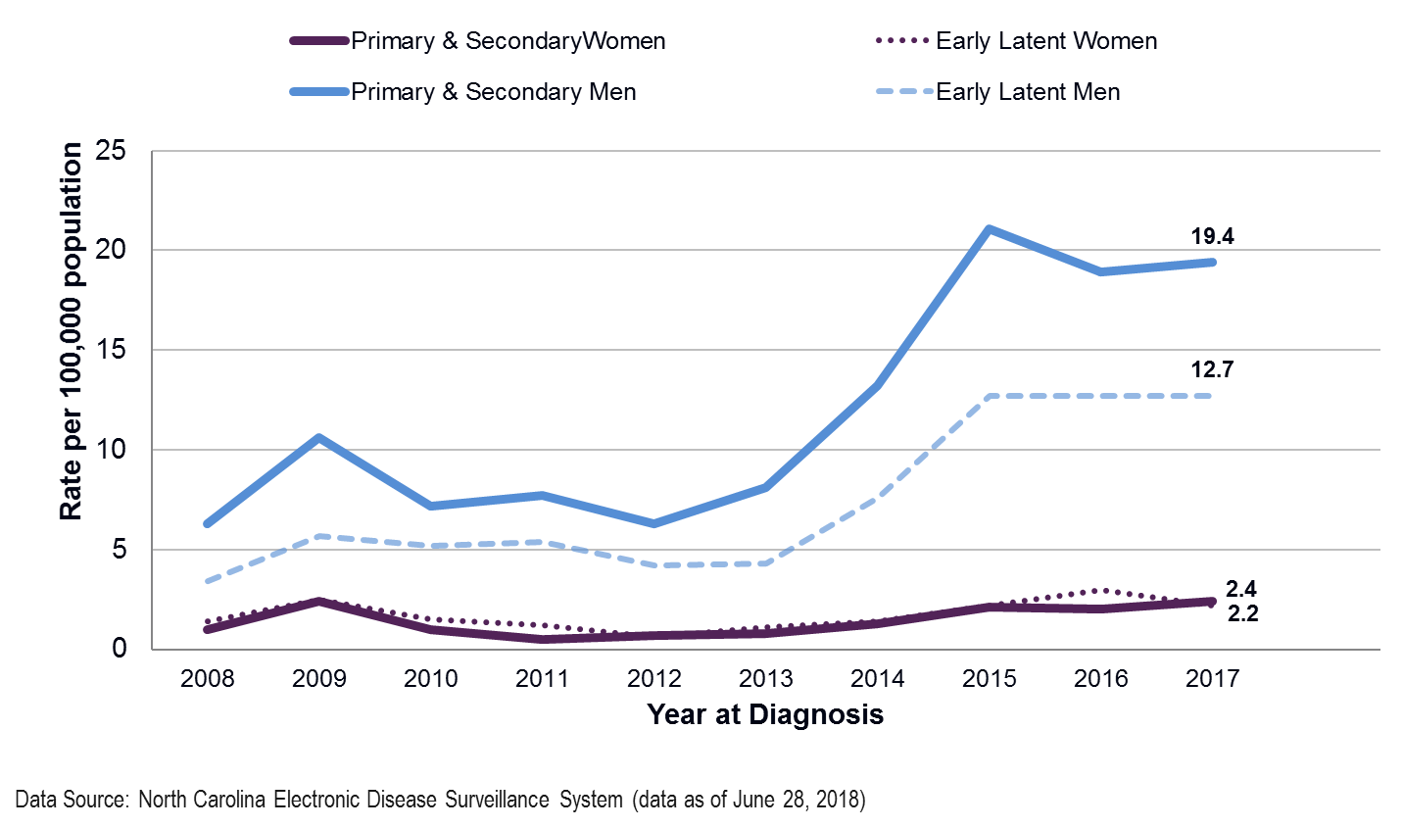

Slide 5
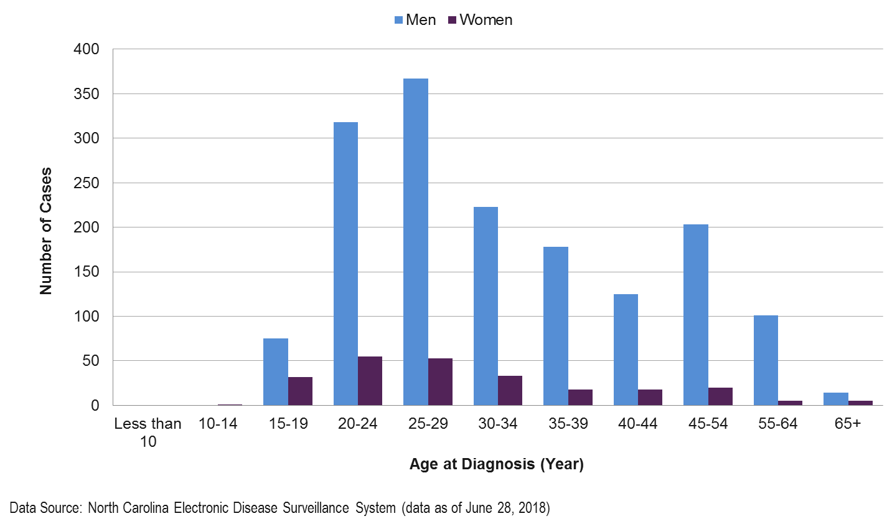

Slide 6
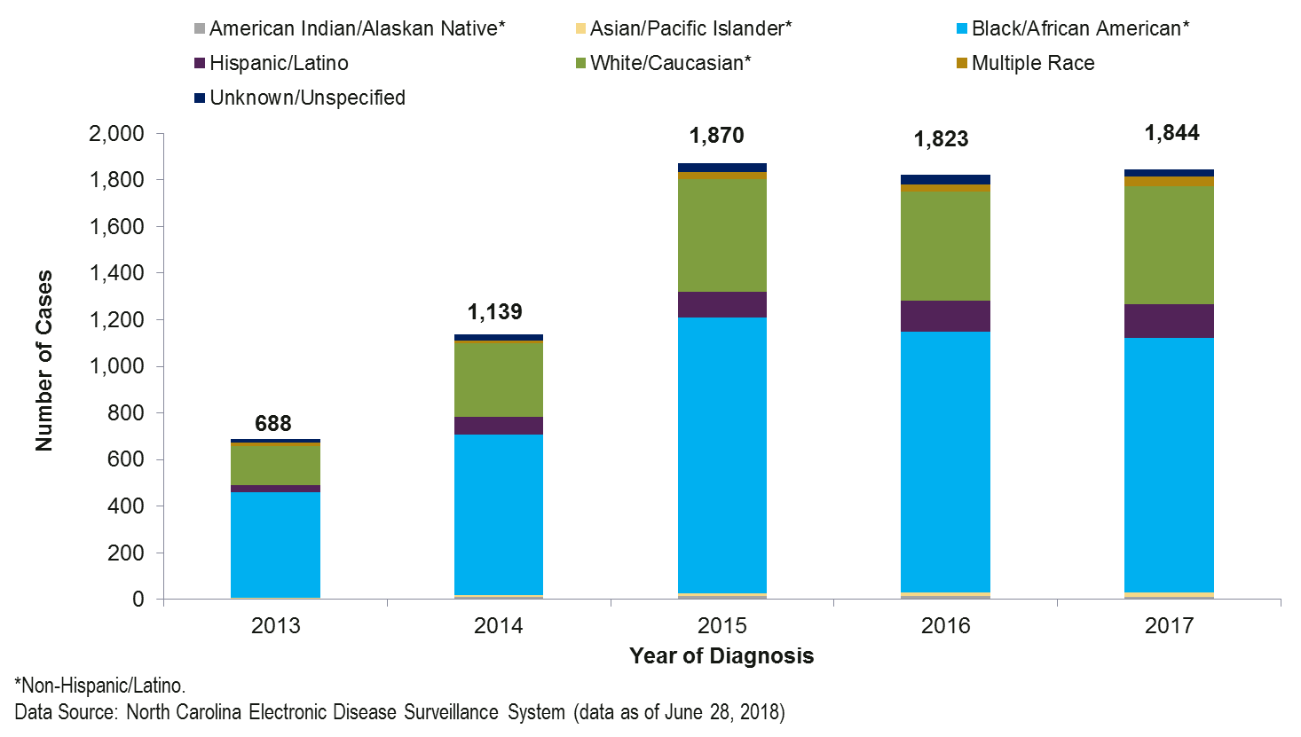

Slide 7
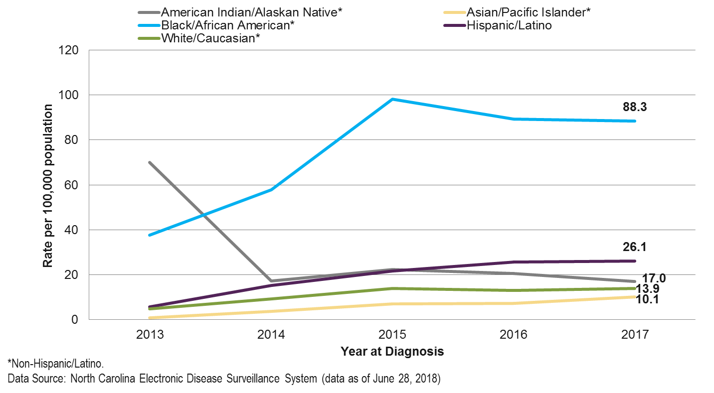

Slide 8
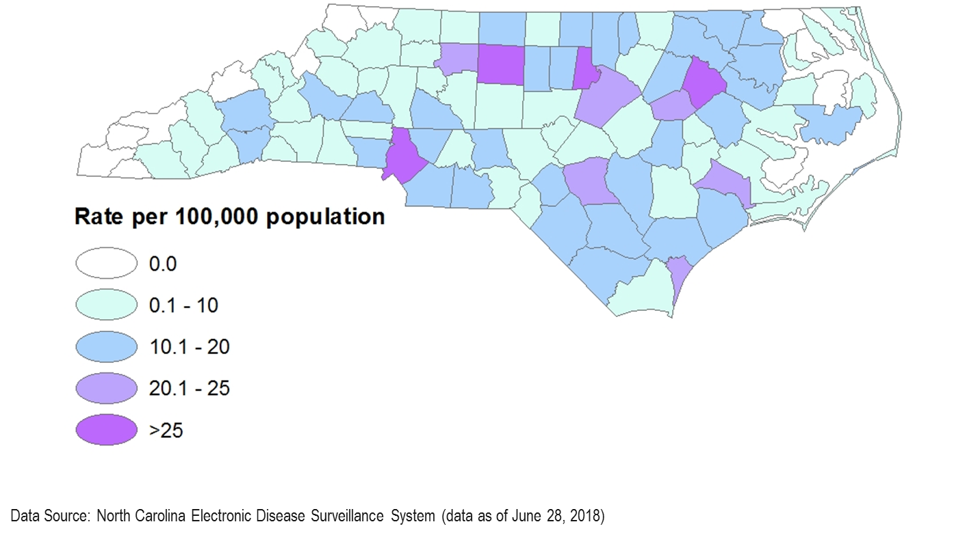

Slide 9
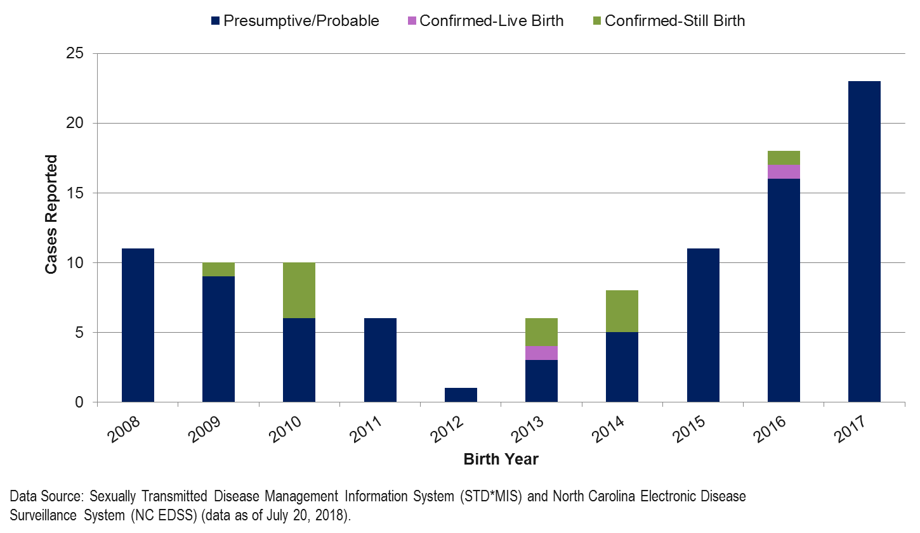

Slide 10
SYPHILIS CO-INFECTION WITH HIV
North Carolina DHHS HIV/STD Surveillance Unit

Slide 11
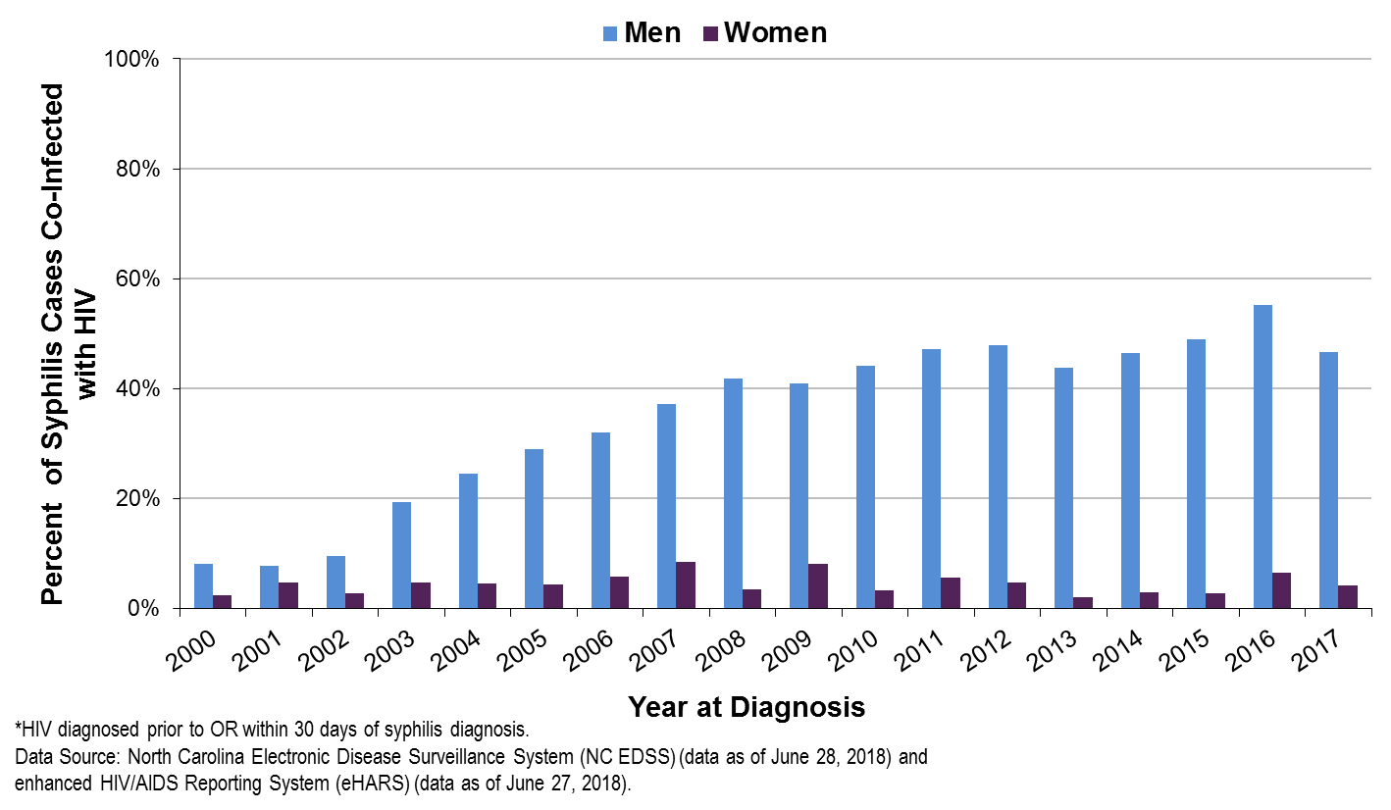

Slide 12
