Slide 1
HIV Epidemiology in North Carolina 2017
November 2018
North Carolina Division of Public Health/Epidemiology Section/Communicable Disease Branch
HIV/STD/Hepatitis Surveillance Unit

Slide 2
HIV PREVALANCE IN NORTH CAROLINA, 2017
North Carolina DHHS HIV/STD/Hepatitis Surveillance Unit

Slide 3
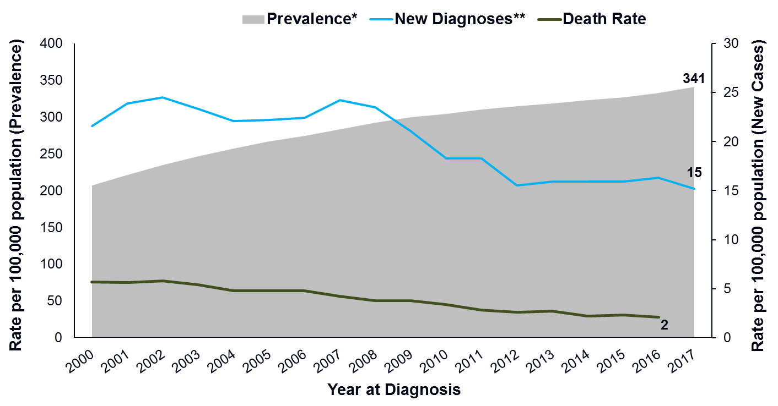

Slide 4
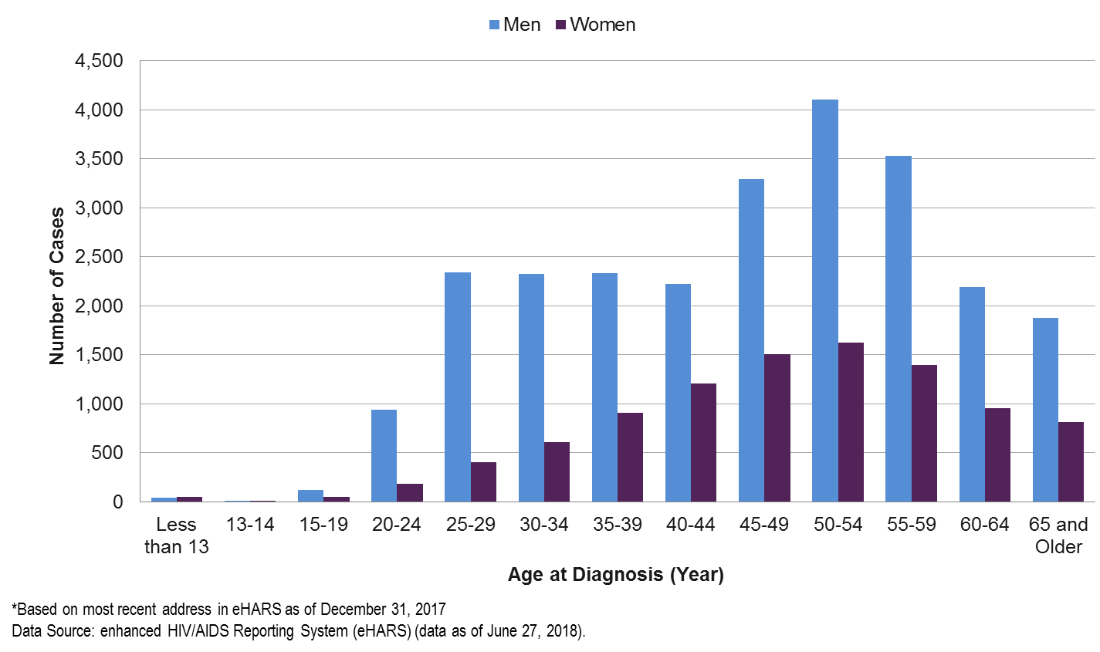

Slide 5
NEWLY DIAGNOSED HIV IN NORTH CAROLINA 2017
North Carolina DHHS HIV/STD Surveillance Unit

Slide 6
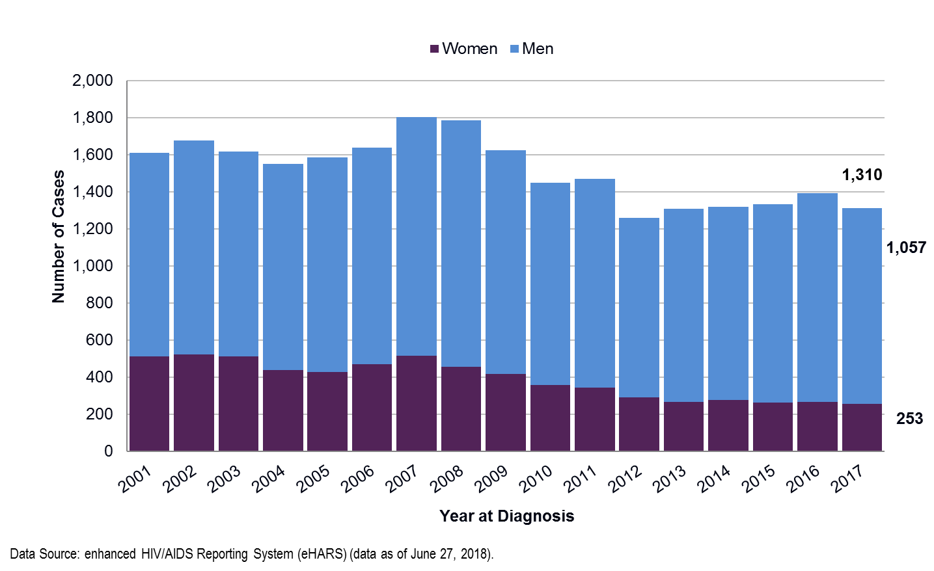

Slide 7
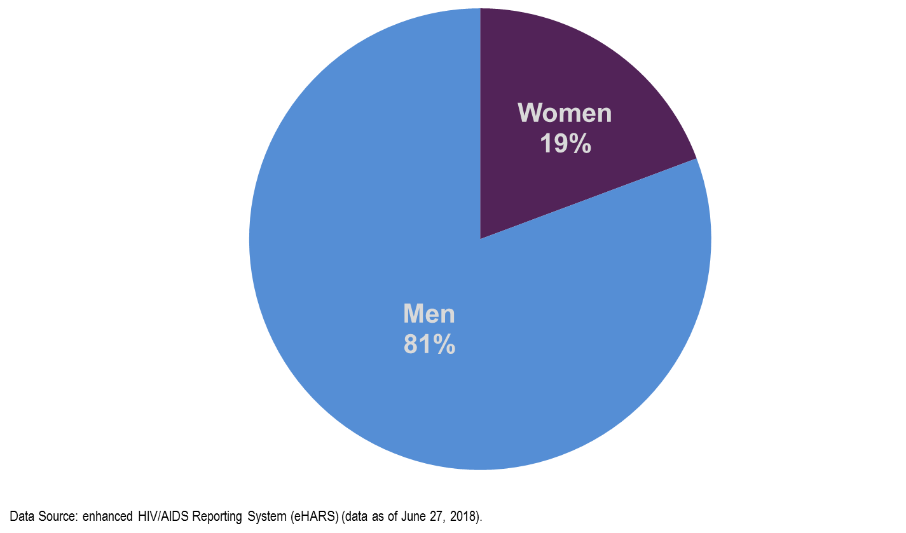
Gender Distribution of Newly Diagnosed Adult/Adolescent (13 years and older) HIV North Carolina, 2017

Slide 8
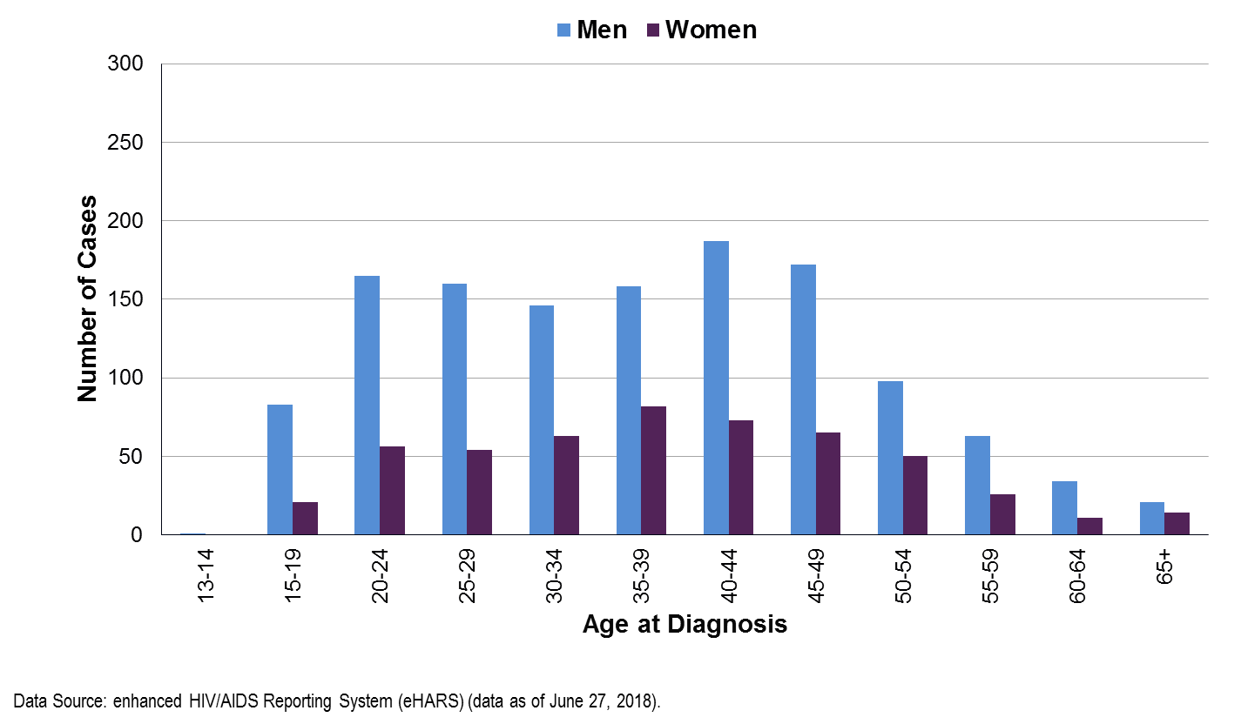

Slide 9
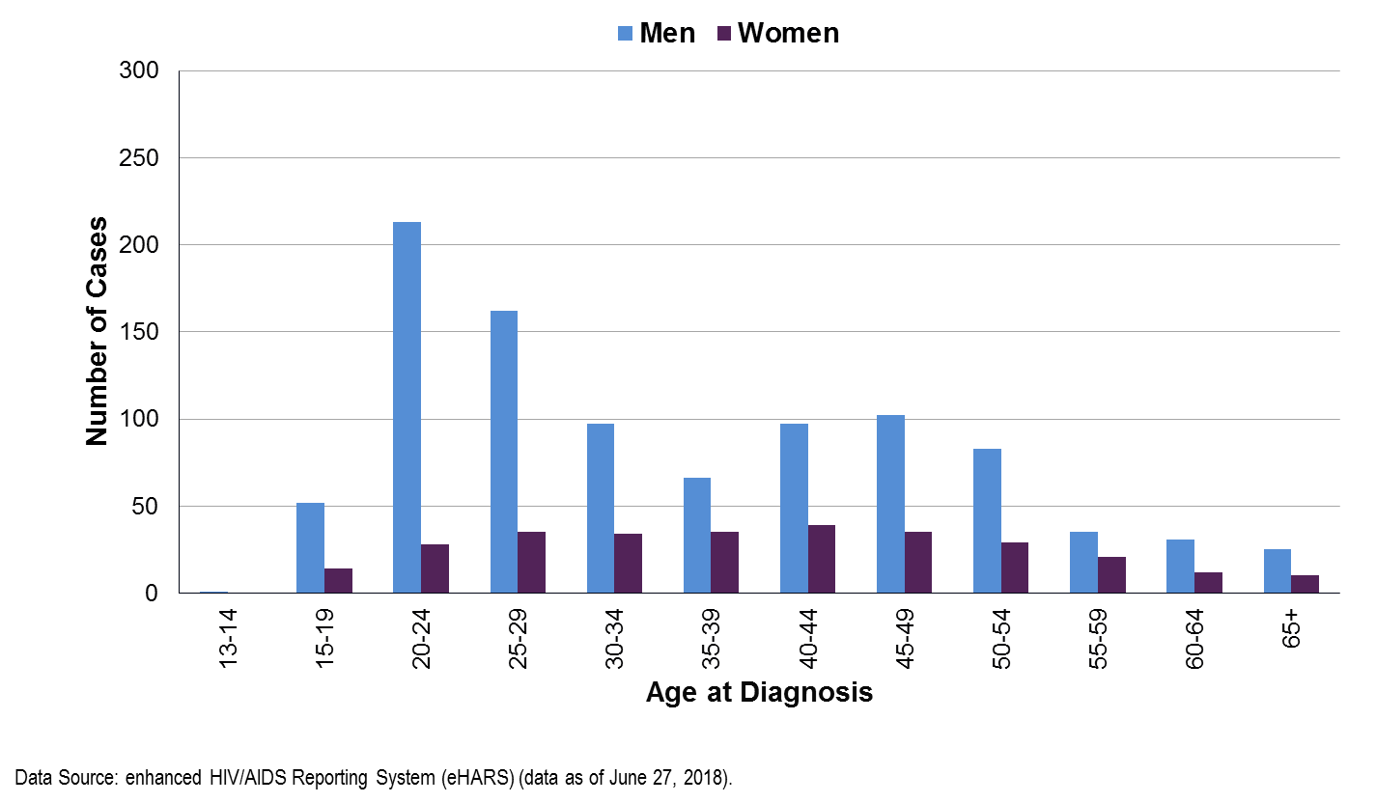

Slide 10
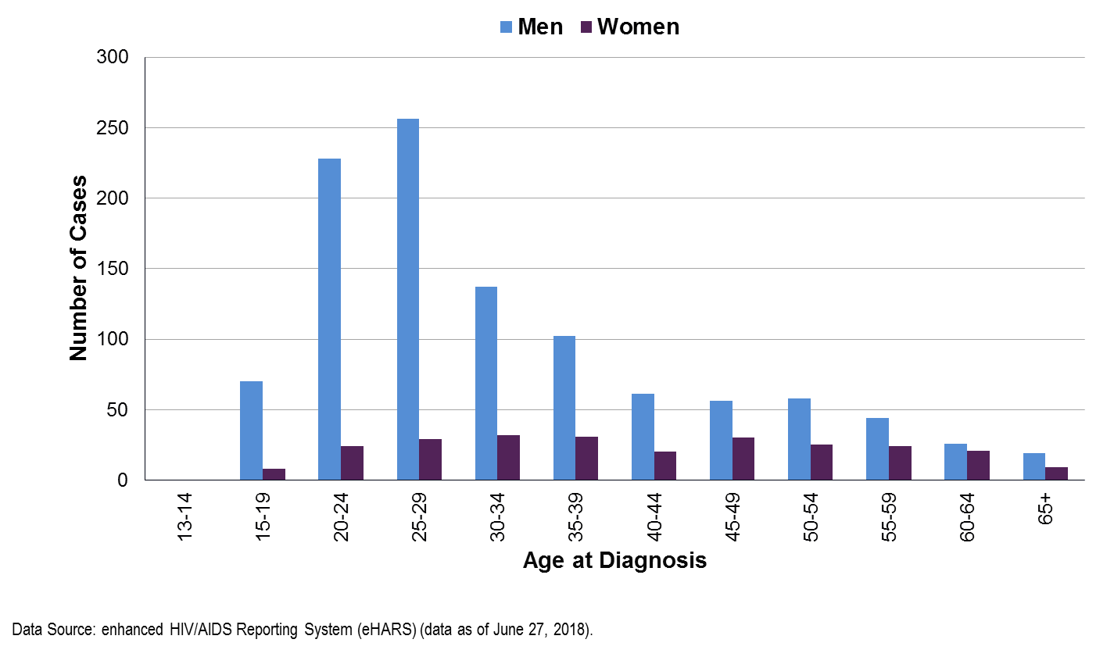

Slide 11
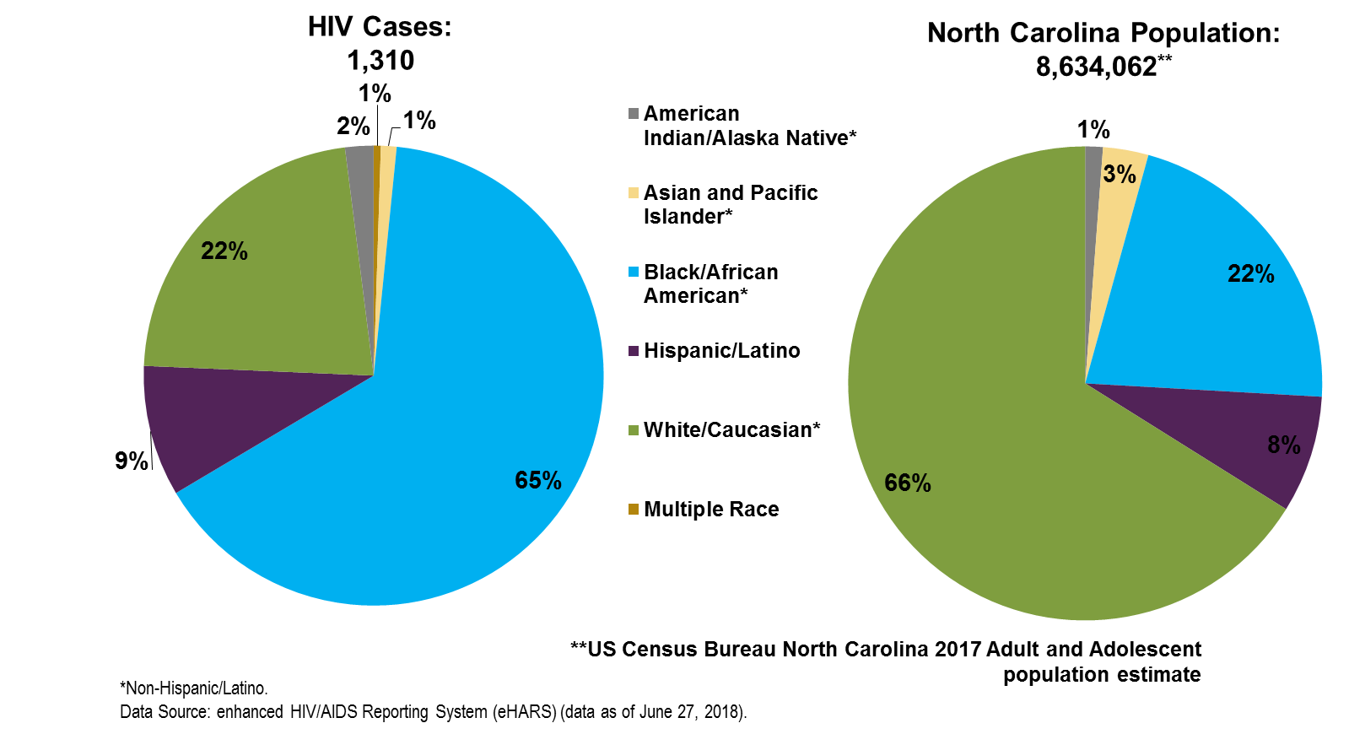

Slide 12
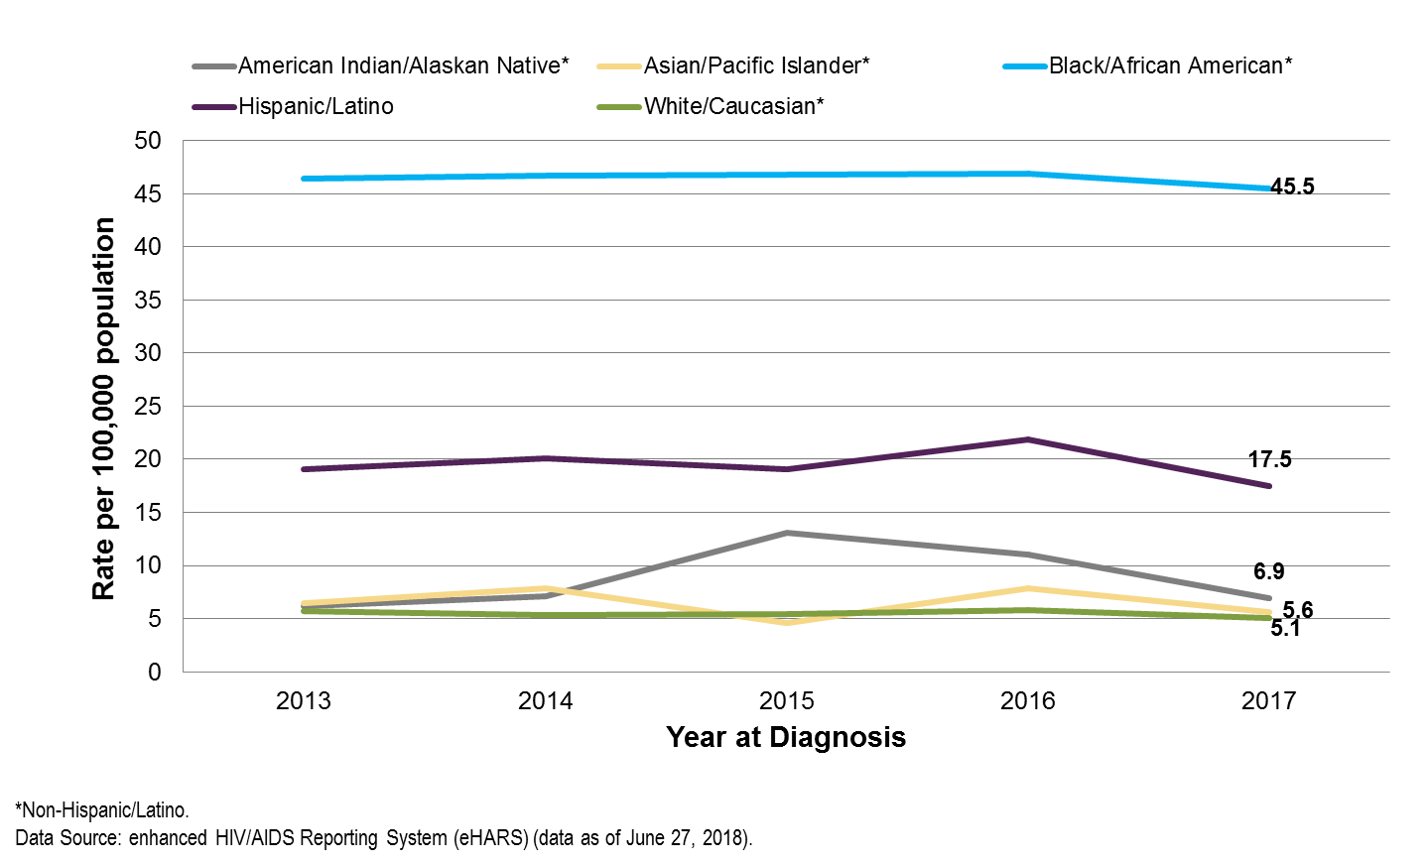

Slide 13
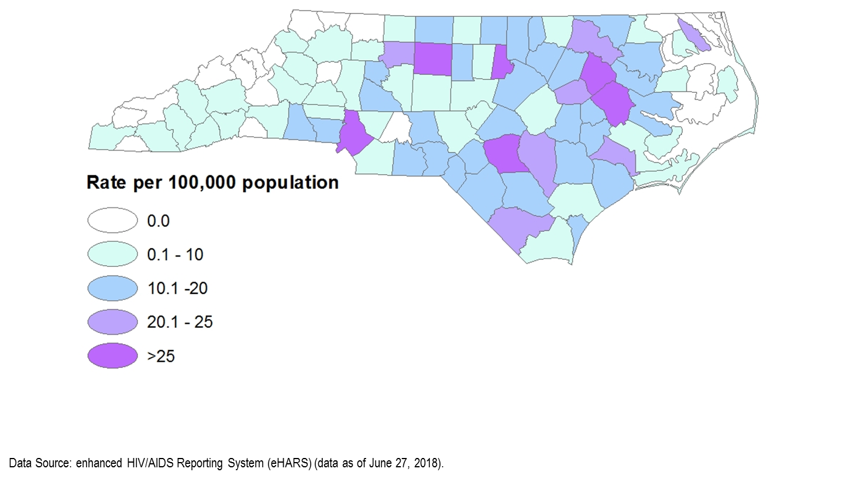

Slide 14
HIV EXPOSURE (HIERARCHICAL RISK)
North Carolina DHHS HIV/STD Surveillance Unit

Slide 15
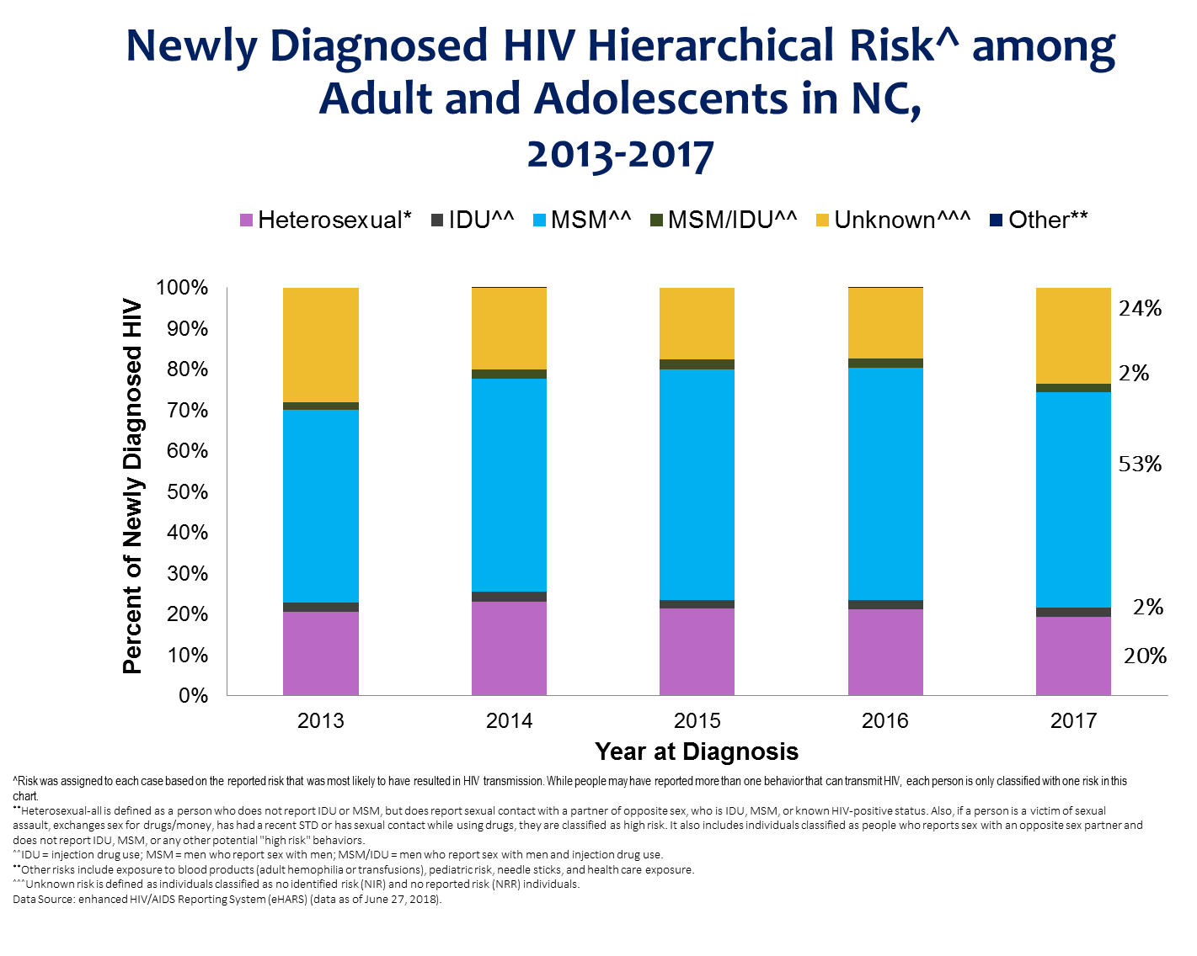

Slide 16
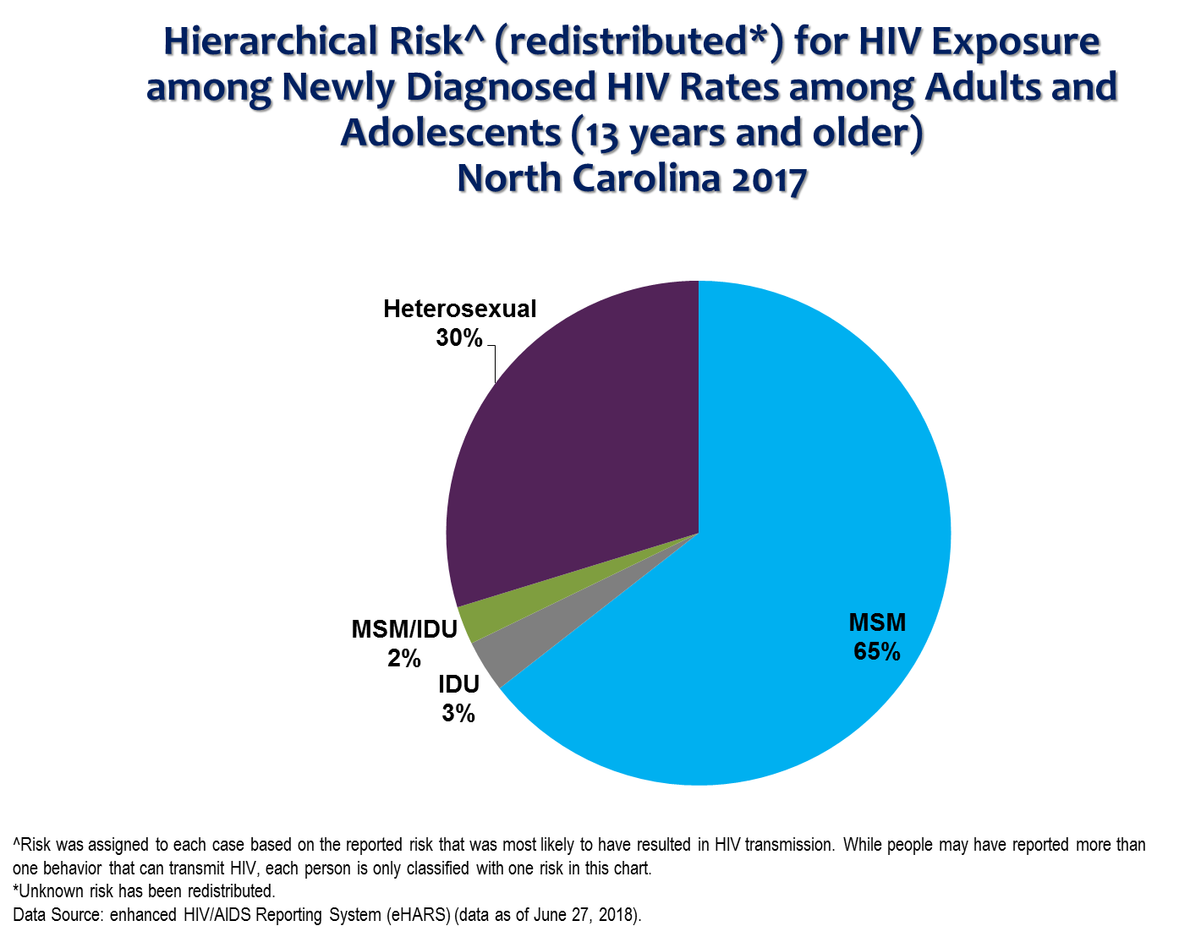

Slide 17
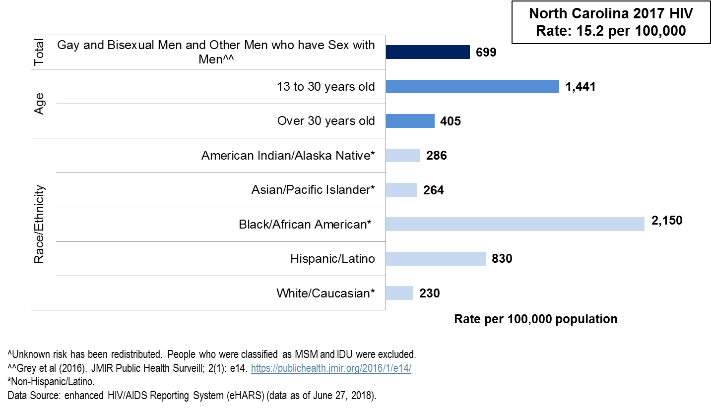

Slide 18
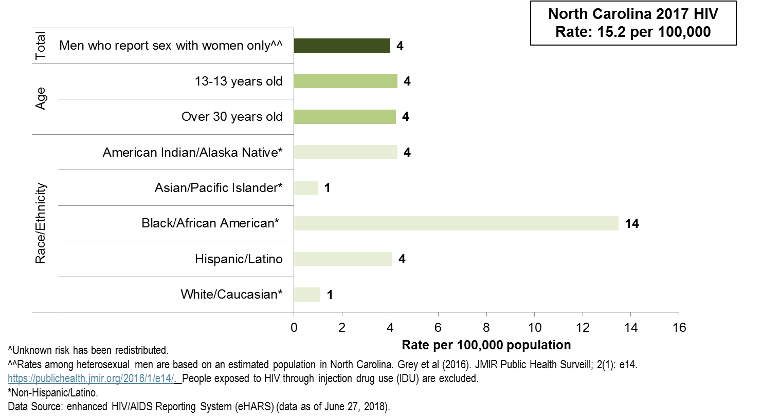

Slide 19
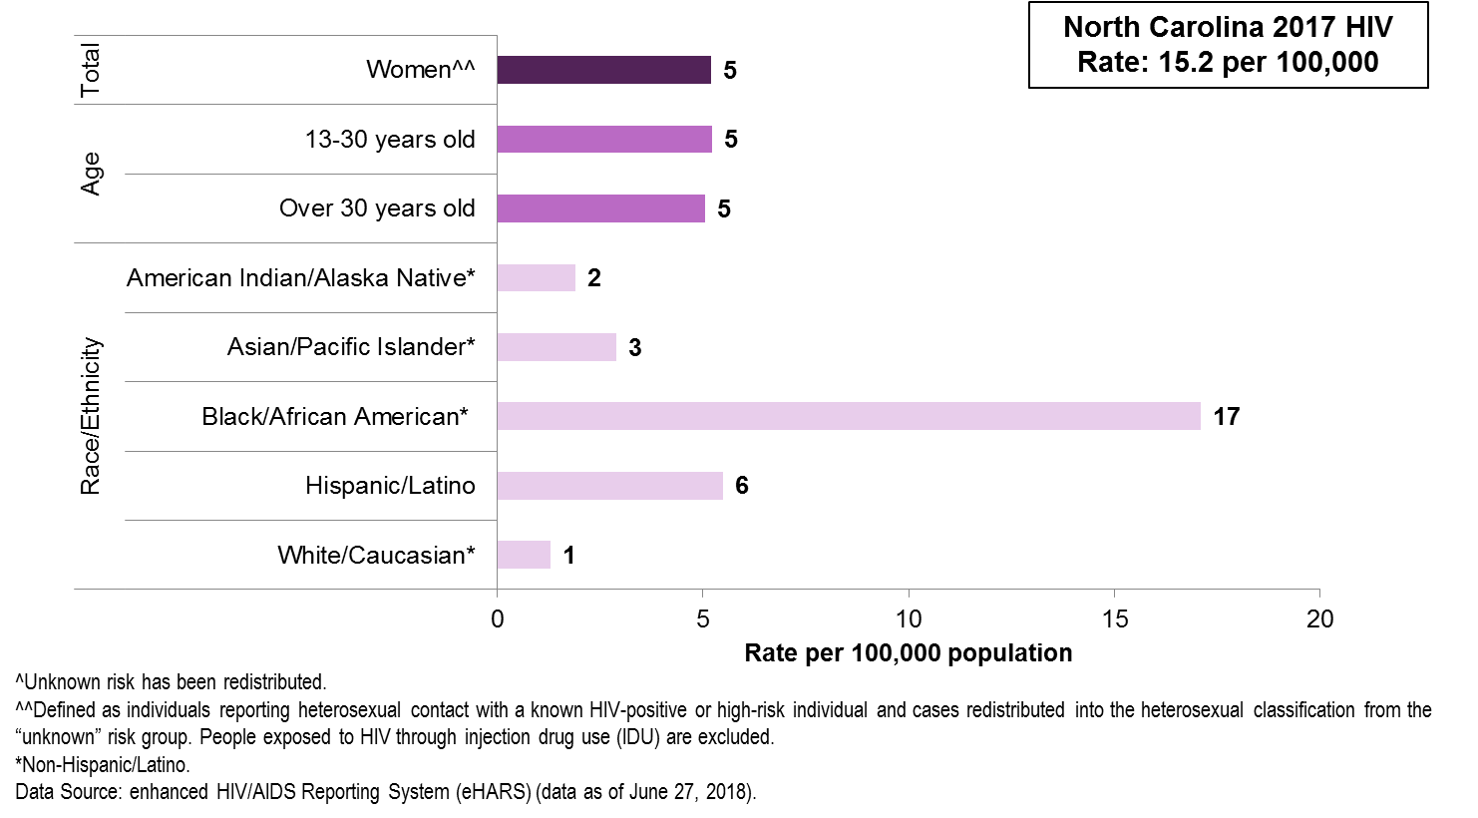

Slide 20
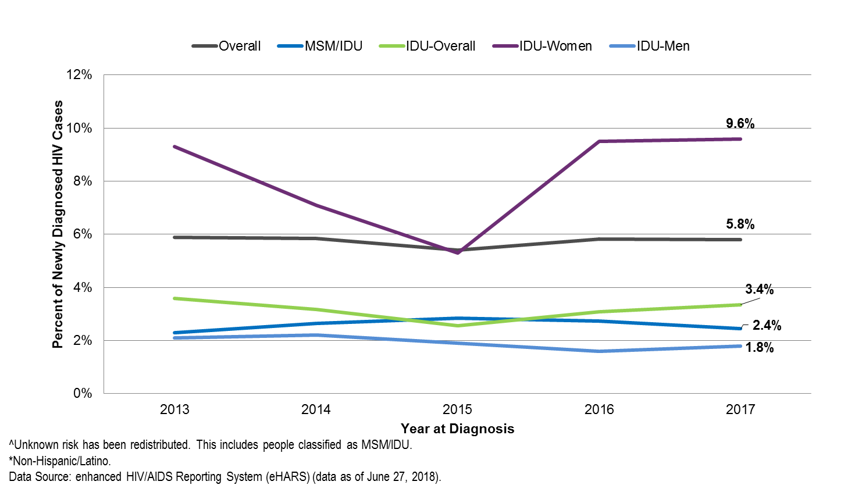

Slide 21
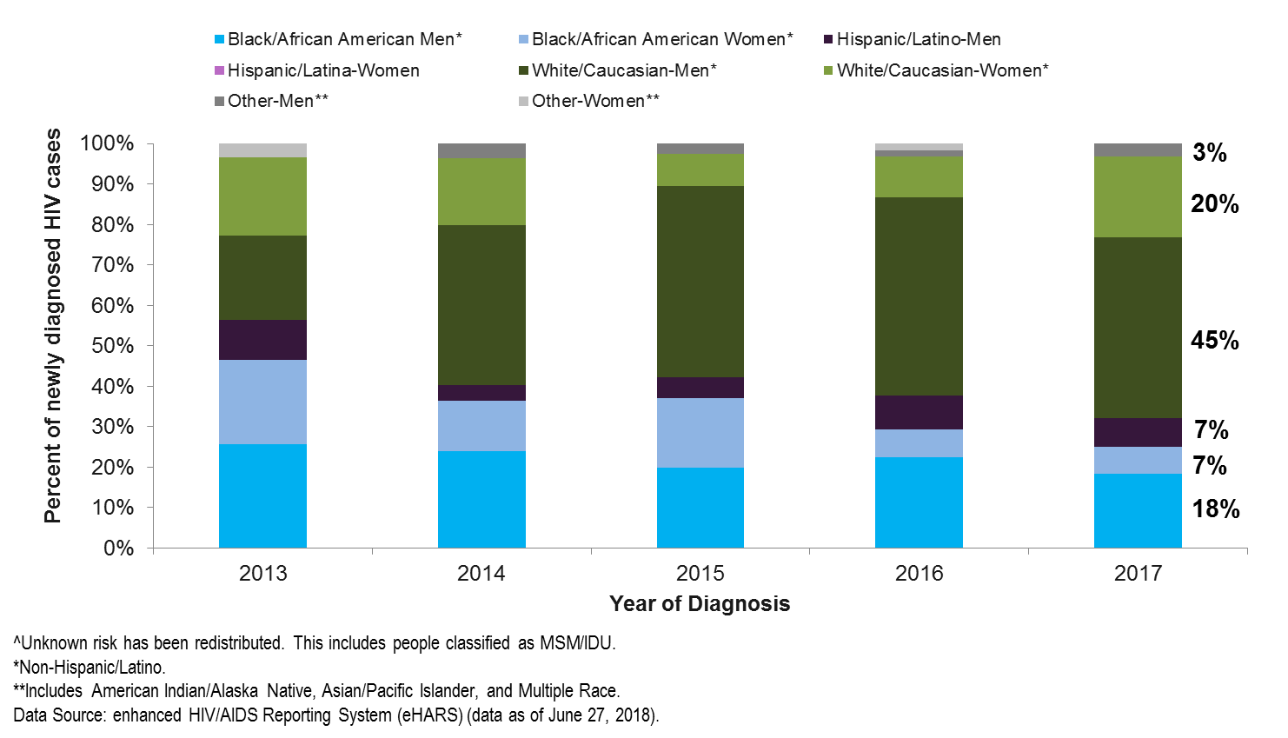

Slide 22
Late Diagnosis of HIV (HIV and AIDS within 6 months)

Slide 23
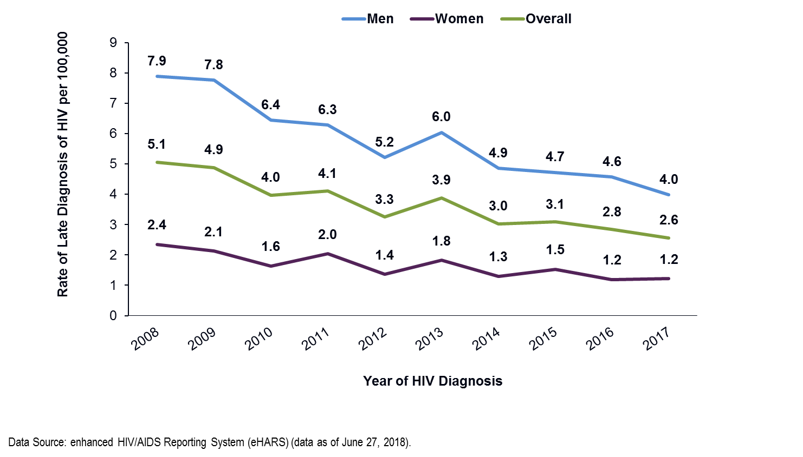

Slide 24
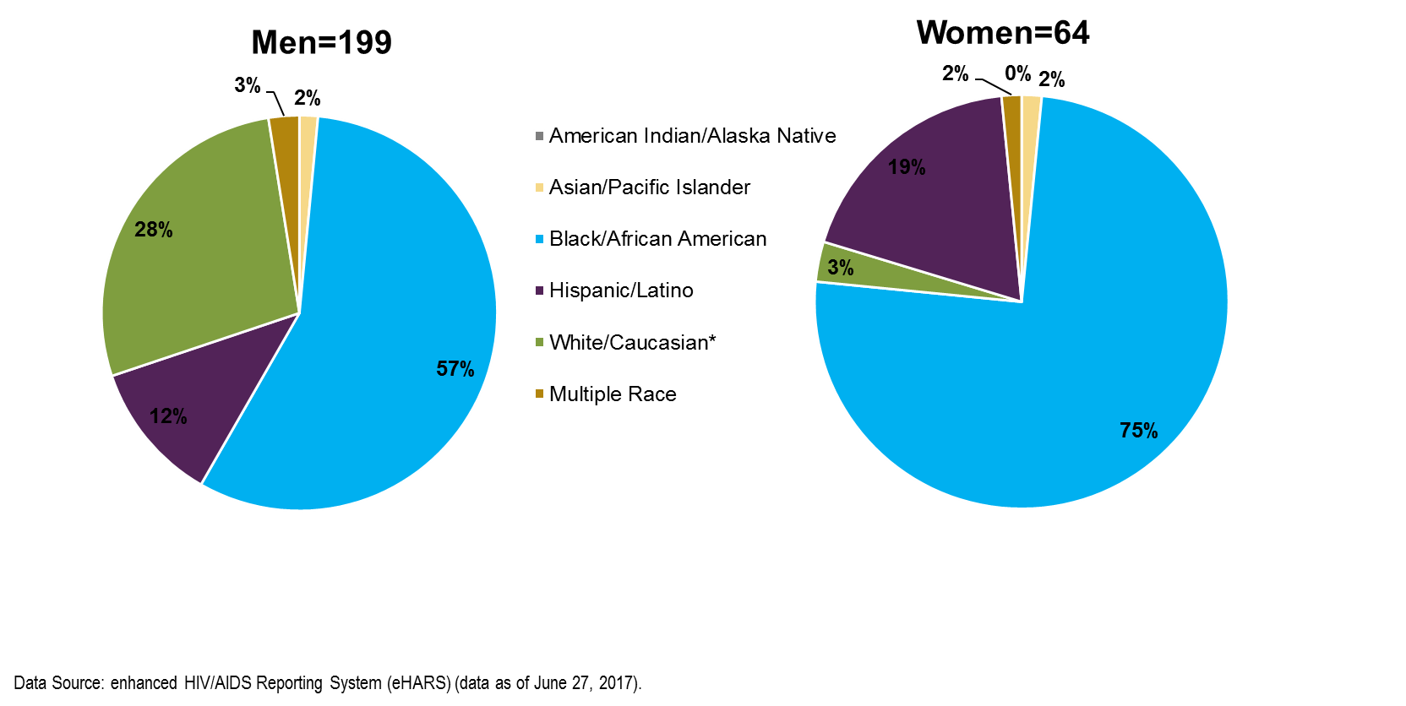

Slide 25
HIV AND HEPATITIS B AND C
North Carolina DHHS HIV/STD Surveillance Unit

Slide 26
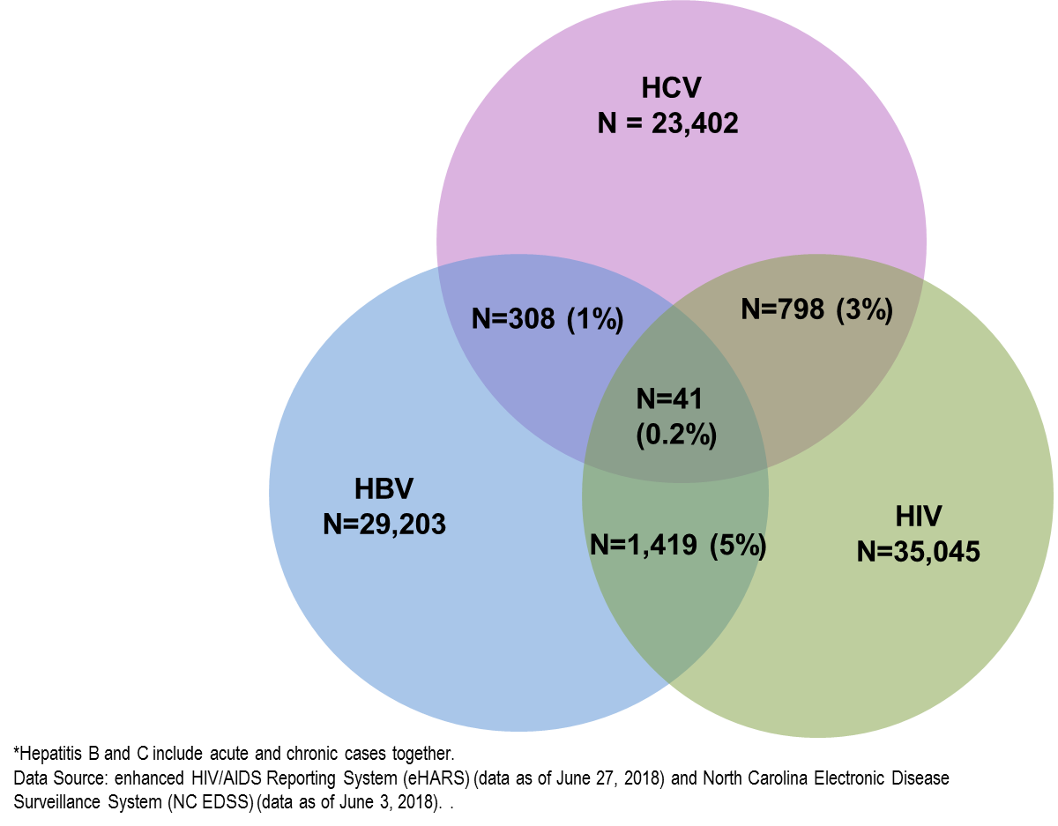
HIV and Hepatitis B and C* Co-infection as of 12/31/2017

