Slide 1
Monthly LHD Update Meeting February 13, 2024

Slide 2
Agenda
Opening Remarks | Stacie Turpin Saunders, MPH Deputy Director/Section Chief, Local and Community Support
Epi Section Update | Zack Moore, MD, MPH State Epidemiologist and Epidemiology Section Chief
MCU Update | Erica Wilson, MD, MPH Medical Director, Medical Consultation Unit
Measles; HPAI; cipro resistant NMn Update | Emma Doran, MD, MPH Medical Director, Vaccine Preventable and Respiratory Diseases
Syphilis Update | Vicki Mobley, MD, MPH Medical Director, HIV/STI
Wastewater Surveillance Update | Molly Deutsch-Feldman Environmental Health
Vaccine Update | Carrie Blanchard, PharmD, MPH Immunization Branch Interim Director
Therapeutics Update | Tim Davis, PharmD, PMP Medical Countermeasures Coordinator
Question & Answer Session | Open for Questions — Please use the Zoom Q&A function

Slide 3
Agenda
Opening Remarks | Stacie Turpin Saunders, MPH Deputy Director/Section Chief, Local and Community Support
Epi Section Update | Zack Moore, MD, MPH State Epidemiologist and Epidemiology Section Chief
MCU Update | Erica Wilson, MD, MPH Medical Director, Medical Consultation Unit
Measles; HPAI; cipro resistant NMn Update | Emma Doran, MD, MPH Medical Director, Vaccine Preventable and Respiratory Diseases
Syphilis Update | Vicki Mobley, MD, MPH Medical Director, HIV/STI
Wastewater Surveillance Update | Molly Deutsch-Feldman Environmental Health
Vaccine Update | Carrie Blanchard, PharmD, MPH Immunization Branch Interim Director
Therapeutics Update | Tim Davis, PharmD, PMP Medical Countermeasures Coordinator
Question & Answer Session | Open for Questions — Please use the Zoom Q&A function

Slide 4
Agenda
Opening Remarks | Stacie Turpin Saunders, MPH Deputy Director/Section Chief, Local and Community Support
Epi Section Update | Zack Moore, MD, MPH State Epidemiologist and Epidemiology Section Chief
MCU Update | Erica Wilson, MD, MPH Medical Director, Medical Consultation Unit
Measles; HPAI; cipro resistant NMn Update | Emma Doran, MD, MPH Medical Director, Vaccine Preventable and Respiratory Diseases
Syphilis Update | Vicki Mobley, MD, MPH Medical Director, HIV/STI
Wastewater Surveillance Update | Molly Deutsch-Feldman Environmental Health
Vaccine Update | Carrie Blanchard, PharmD, MPH Immunization Branch Interim Director
Therapeutics Update | Tim Davis, PharmD, PMP Medical Countermeasures Coordinator
Question & Answer Session | Open for Questions — Please use the Zoom Q&A function

Slide 5
Agenda
Opening Remarks | Stacie Turpin Saunders, MPH Deputy Director/Section Chief, Local and Community Support
Epi Section Update | Zack Moore, MD, MPH State Epidemiologist and Epidemiology Section Chief
MCU Update | Erica Wilson, MD, MPH Medical Director, Medical Consultation Unit
Measles; HPAI; cipro resistant NMn Update | Emma Doran, MD, MPH Medical Director, Vaccine Preventable and Respiratory Diseases
Syphilis Update | Vicki Mobley, MD, MPH Medical Director, HIV/STI
Wastewater Surveillance Update | Molly Deutsch-Feldman Environmental Health
Vaccine Update | Carrie Blanchard, PharmD, MPH Immunization Branch Interim Director
Therapeutics Update | Tim Davis, PharmD, PMP Medical Countermeasures Coordinator
Question & Answer Session | Open for Questions — Please use the Zoom Q&A function

Slide 6
Measles Key Points
Increase in measles circulation within the US and globally
No reported cases in North Carolina since 2018
Increase in North Carolina travel-related contacts (via CDC DGMH travel notifications). No contacts have developed symptoms
Resources on the CD Manual:
NCSLPH Measles Specimen Collection and Testing Guidelines
Measles Investigation Guidelines

Slide 7
When Investigating Potential Measles Cases, Follow the ICE Acronym
Immune status?
Shot record, disease history?
Vaccine effectiveness?
Waning immunity?
Clinical presentation?
Onset date of each symptom?
Classic or modified presentation?
Lab results-can they rule in/out disease?
Epi?
What is incubation period? Infectious period?
Demographics, pregnancy status, pre-existing conditions, travel, employment, activities, school, congregate settings?
Notes:
All investigations of vaccine preventable diseases begin with answering 3 basic questions. We use the acronym ICE.
The I stands for immune status. Is this person vaccinated? Have they had disease in the past? Is the disease of concern one that has lower vaccine effectiveness? Does immunity wane over time?
The C is for clinical presentation. Are the symptoms consistent with typical disease? What is the case definition criteria? Has the patient been tested for other diseases? What other conditions can cause such a clinical picture? Would past vaccination modify the clinical picture? How do we interpret the laboratory results?
The E is for Epidemiology and represents the factors affecting disease transmission. Does the clinical presentation and timing of symptoms fit with what we know about the typical progression of disease and the incubation period? Has the patient traveled? Does the patient have potential exposure in other settings?

Slide 8
Measles Laboratory Testing
To request measles testing, immediately notify CDB (919-733-3419). Measles is a public health emergency
Measles testing is available through SLPH or select commercial laboratories. Prior approval is required for testing at SLPH
Oropharyngeal or nasopharyngeal swab should be collected for PCR and viral culture. Serum should be collected for IgM serology. Call CDB for consultation
https://epi.dph.ncdhhs.gov/cd/lhds/manuals/cd/measles/Measles_Investigation_Guidelines.pdf

Slide 9
Presumptive Evidence of Immunity for Measles Contacts
Acceptable presumptive evidence of measles immunity includes at least one of the following:
written documentation of adequate vaccination— receipt of one or more doses of a measles-containing vaccine administered on or after the first birthday for preschool-age children and adults not at high risk, and two doses of measles-containing vaccine for school-age children and adults at high risk for exposure transmission (i.e., health care personnel, international travelers, and students at post-high school educational institutions); or
laboratory evidence of immunity; or
birth before 1957 (consult CDB if healthcare worker); or
laboratory confirmation of prior disease in medical record.
Persons who do not meet the above criteria are considered susceptible and should be vaccinated unless contraindicated.
https://www.cdc.gov/vaccines/pubs/surv-manual/chpt07-measles.html

Slide 10
Increase in Ciprofloxacin- and Penicillin-Resistant Meningococcal Disease
3 cases of ciprofloxacin- and penicillin-resistant strains of invasive meningococcal disease have been identified in the Mecklenburg area over the last year. Two in Mecklenburg County and one in a South Carolina resident from neighboring York County.
We are working with the CDC to develop the geographic area where alternative post-exposure prophylaxis (PEP) for close contacts should be used. A memo will be released later this week with details.
Providers in this area should discontinue use of ciprofloxacin for prophylaxis of close contacts and prescribe rifampin, ceftriaxone, or azithromycin instead.

Slide 11
Commercial Poultry Flock with Positive HPAI Tests
A commercial flock in North Carolina tested positive for H5N1 HPAI.
As we enter the spring migration season there will likely be more cases of HPAI in commercial flocks.
LHDs should prepare for positive tests with preventive messaging and be ready to monitor exposed individuals.
Monitoring involves 2 calls, one initial and a follow-up at 7 days after the last date of exposure and completing a REDCap survey
Provide self-monitoring instructions from the CD manual: https://epi.dph.ncdhhs.gov/cd/flu/hpai/DraftMonitoringInstructionsForExposedPersons030322.docx
Instruct the person to call you or the Epi on-call (919-733-3419) in case of ILI symptoms.
Additional guidance is available in the CD Manual toolkit for Avian Influenza

Slide 12
Agenda
Opening Remarks | Stacie Turpin Saunders, MPH Deputy Director/Section Chief, Local and Community Support
Epi Section Update | Zack Moore, MD, MPH State Epidemiologist and Epidemiology Section Chief
MCU Update | Erica Wilson, MD, MPH Medical Director, Medical Consultation Unit
Measles; HPAI; cipro resistant NMn Update | Emma Doran, MD, MPH Medical Director, Vaccine Preventable and Respiratory Diseases
Syphilis Update | Vicki Mobley, MD, MPH Medical Director, HIV/STI
Wastewater Surveillance Update | Molly Deutsch-Feldman Environmental Health
Vaccine Update | Carrie Blanchard, PharmD, MPH Immunization Branch Interim Director
Therapeutics Update | Tim Davis, PharmD, PMP Medical Countermeasures Coordinator
Question & Answer Session | Open for Questions — Please use the Zoom Q&A function

Slide 13
Syphilis Update
February 13, 2024

Slide 14
Syphilis is most common among men, but increasing fastest among women, during 2023*
Early Syphilis by Gender and Partner Gender
North Carolina, 2023
Increase in Early Syphilis by Gender and Partner Gender
North Carolina, 2023 Compared 2020-2022 Average
*2023 data is still preliminary and subject to change.
Data Source: North Carolina Electronic Disease Surveillance System (NC EDSS) (data as January 25, 2024).

Slide 15
Congenital Syphilis Cases Continued to Rise in 2023*
*2023 data is still preliminary and subject to change.
Data Source: Sexually Transmitted Disease Management Information System (STD*MIS) and North Carolina Electronic Disease Surveillance System (NC EDSS) (data as January 25, 2024).

Slide 16
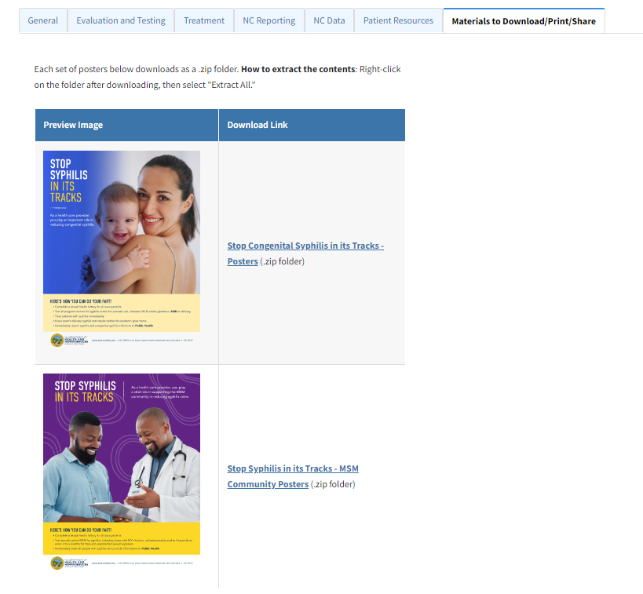
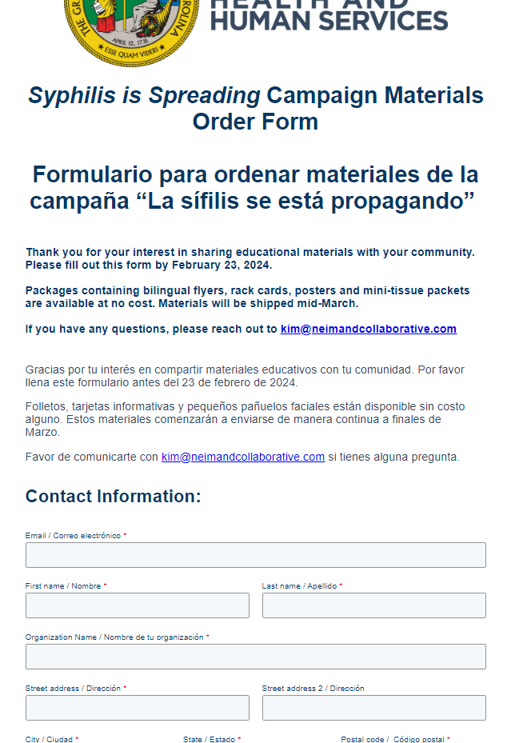
Congenital Syphilis Resources for Providers | Division of Public Health (ncdhhs.gov)
Form (hsforms.com)

Slide 17
Agenda
Opening Remarks | Stacie Turpin Saunders, MPH Deputy Director/Section Chief, Local and Community Support
Epi Section Update | Zack Moore, MD, MPH State Epidemiologist and Epidemiology Section Chief
MCU Update | Erica Wilson, MD, MPH Medical Director, Medical Consultation Unit
Measles; HPAI; cipro resistant NMn Update | Emma Doran, MD, MPH Medical Director, Vaccine Preventable and Respiratory Diseases
Syphilis Update | Vicki Mobley, MD, MPH Medical Director, HIV/STI
Wastewater Surveillance Update | Molly Deutsch-Feldman Environmental Health
Vaccine Update | Carrie Blanchard, PharmD, MPH Immunization Branch Interim Director
Therapeutics Update | Tim Davis, PharmD, PMP Medical Countermeasures Coordinator
Question & Answer Session | Open for Questions — Please use the Zoom Q&A function

Slide 18
NC Wastewater Monitoring Network Update
NCWMN Epi/GIS Team
Occupational and Environmental Epidemiology Branch

Slide 19
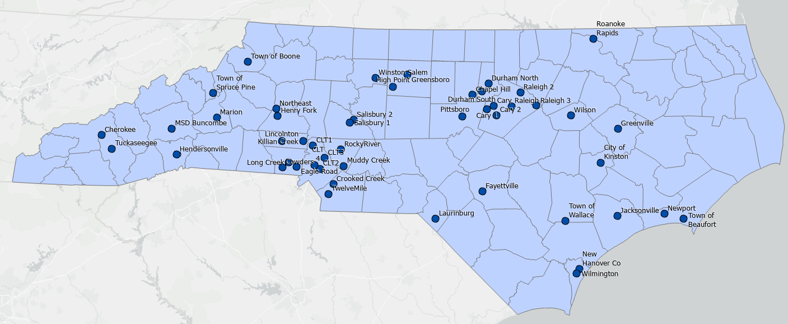
47 Sites in the Network
Notes:
This is a map of our current wastewater monitoring network. We have 47 sites across the state.

Slide 20
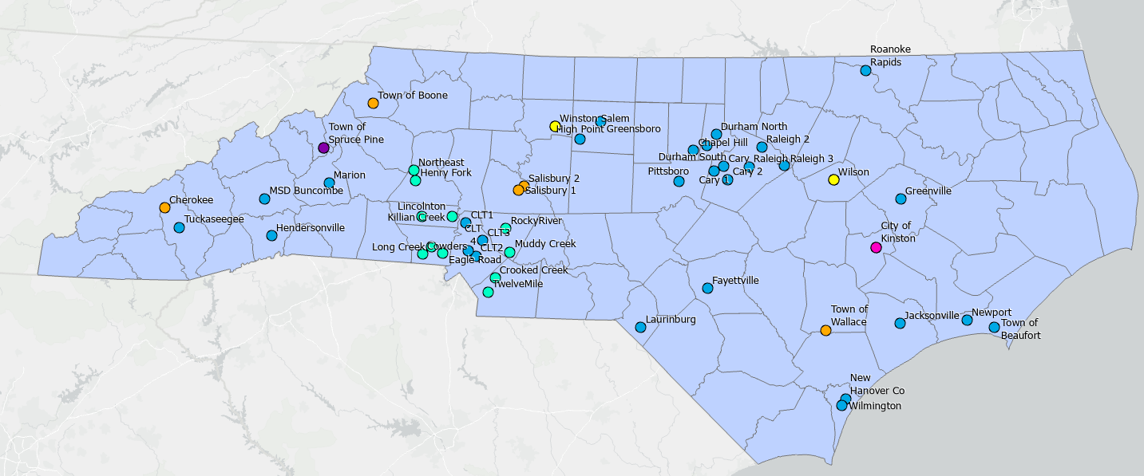
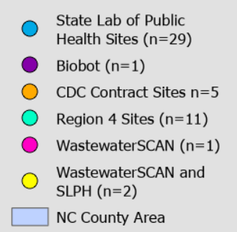
Multiple laboratory partners
Notes:
Those sites work with a variety of lab partners, which you can see color coded here. Those include our state lab of public health, CDC, and private contracted companies.

Slide 21
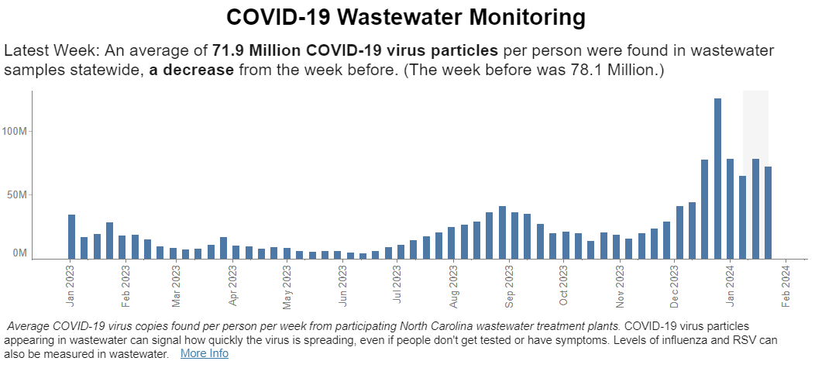
Maintaining high levels
https://covid19.ncdhhs.gov/dashboard
Notes:
We are still seeing relatively high levels of virus in wastewater. This is our state aggregated metric with the most updated data. You can see that we had a big jump coinciding with the holiday season, and we've come down a bit, but the overall levels remain high.

Slide 22
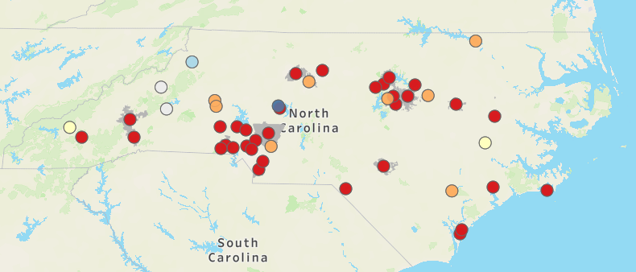
SARS-CoV-2 Wastewater LEVELS
NC Sites (current as of 01/31): 41/45 sites are in the highest 2 percentiles
Notes:
We can also look at the viral levels at each of our sites. This figure displays the viral level percentiles when we look at all of the data collected for that site. You can see that most of the sites are red, which means they are in the highest percentile.

Slide 23
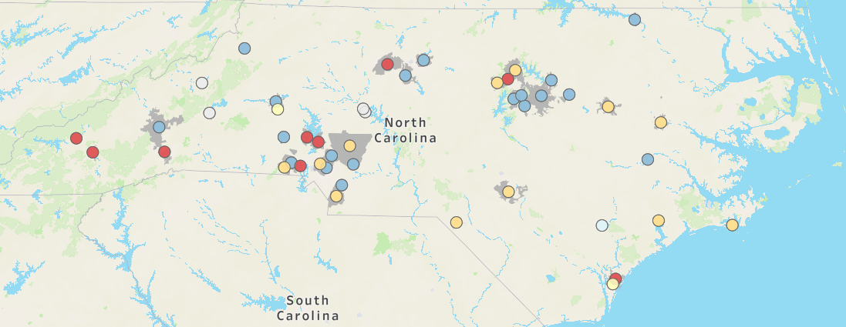
SARS-CoV-2 Wastewater TRENDS
NC Sites (current as of 01/31): 20/45 sites are decreasing
Notes:
But we also look at the trend, so not just the current level but how have the levels changed over the past 15 days. And many of our sites are decreasing, as indicated by the blue dots. So that is good to see and provides some hope that we may be on a downward trend.

Slide 24
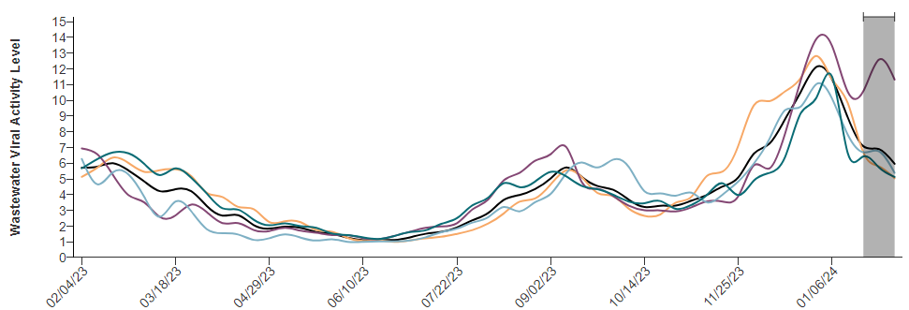
Southern Region has the highest levels, but may have peaked – NEW CDC Wastewater Dashboard
Updated 02/07/2024
Omicron BA1
Vaccinations
Delta
Public health emergency ends
Rollout of
home testing
Notes:
CDC is now posting updates on their dashboard as well and they have been generating state and regional aggregated metrics. You can see here that the southern region in purple is much higher than the other regions, but does show a drop recently. You can select and highlight single regions on the dashboard as well.

Slide 25
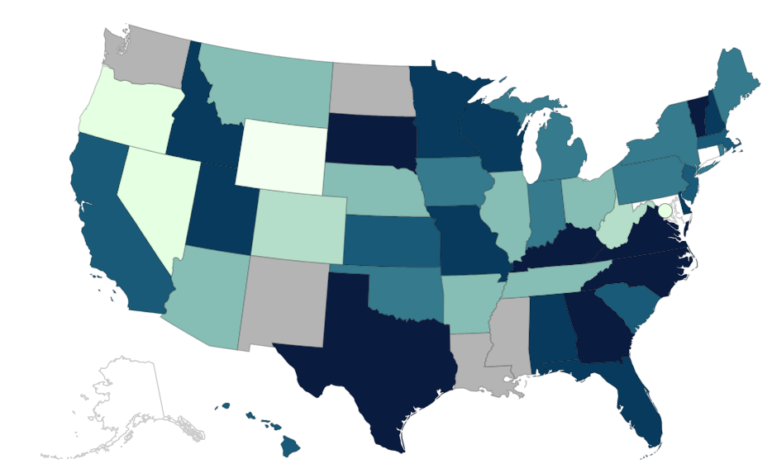
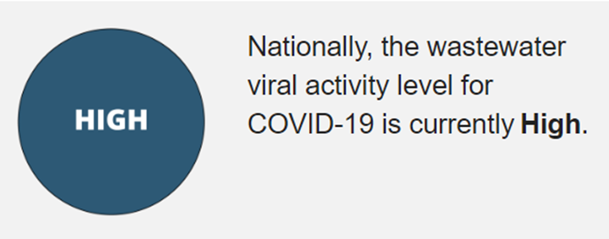
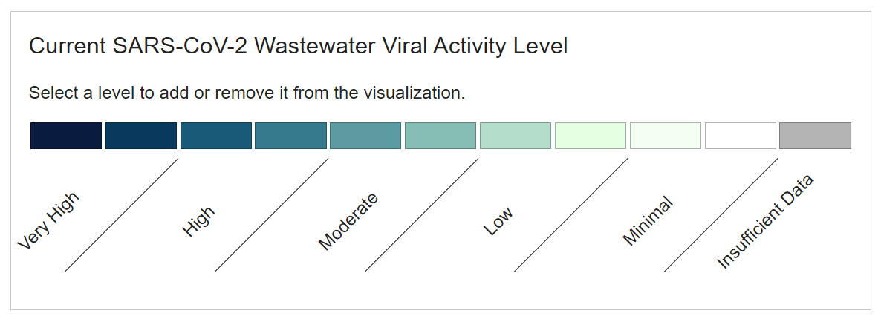
National Wastewater Trends – NEW CDC WW Dashboard
Updated 02/07/2024
Notes:
CDC is also displaying state aggregated metrics, which are binned into categories. The darker blue indicates higher wastewater viral activity levels an the lighter colors are lower levels. They also have an national category which is currently high. And I'll just mention that these new updates from CDC are quite a big deal, because harmonizing and aggregating data from multiple sites iwthin states and then across many states is no small feat. So really interesting to see this on the CDC dashboard.

Slide 26
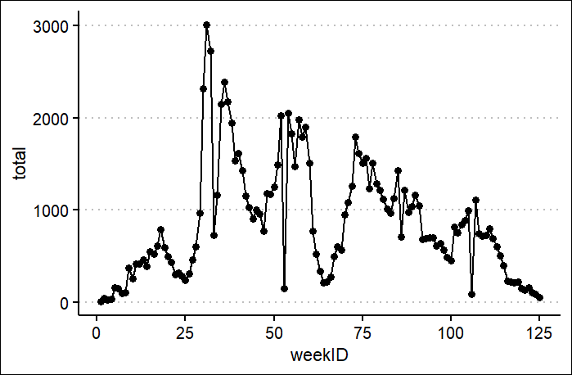
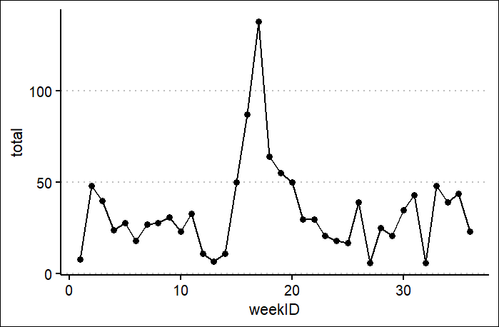
Number of sequenced clinical samples submitted to NCDHHS weekly
During public health emergency:
01/01/2021 – 5/11/2023
Weekly average = 861
Post public health emergency:
5/12/2023 – 1/15/2024
Weekly average = 34
Notes:
We've been routinely sequencing clinical samples to identify and monitor SARS-CoV-2 variants since the beginning of 2021. The sequencing is performed at various labs around the state and then the data are shared with u sat NCDHHS. However, we've seen a steep decrease in sequenced samples over the past year or so. On the left...
I'll note that this decline did begin before the public health emergency ended, it really started at the beginning of 2023, but has remained quite low over the past year as covid is no longer a reportable condition.
This really limits our ability to detect and monitor new variants so we have been incorporating wastewater sequencing into our surveillance program as well.

Slide 27
Clinical and Wastewater Sequencing Comparison
Clinical Samples
Wastewater
Notes:
We can compare the sequencing results from our clinical samples with those from wastewater to get a more complete sense of which variants are circulating. The two tell similar stories..can see HV.1 and now JN.1

Slide 28
Agenda
Opening Remarks | Stacie Turpin Saunders, MPH Deputy Director/Section Chief, Local and Community Support
Epi Section Update | Zack Moore, MD, MPH State Epidemiologist and Epidemiology Section Chief
MCU Update | Erica Wilson, MD, MPH Medical Director, Medical Consultation Unit
Measles; HPAI; cipro resistant NMn Update | Emma Doran, MD, MPH Medical Director, Vaccine Preventable and Respiratory Diseases
Syphilis Update | Vicki Mobley, MD, MPH Medical Director, HIV/STI
Wastewater Surveillance Update | Molly Deutsch-Feldman Environmental Health
Vaccine Update | Carrie Blanchard, PharmD, MPH Immunization Branch Interim Director
Therapeutics Update | Tim Davis, PharmD, PMP Medical Countermeasures Coordinator
Question & Answer Session | Open for Questions — Please use the Zoom Q&A function

Slide 29
Today’s agenda
2024 Immunization Conference
General Updates/Reminders
COVID-19 Vaccine Updates
Flu Updates
RSV Updates
Mpox Updates
Measles Updates
NCIR Updates
Questions

Slide 30
Save the Date! 2024 Conference May 8-10, 2024, Durham, NC
Plan now to join us for the Vaccines for Children conference at the Sheraton Imperial Hotel in Research Triangle Park, NC.
Registration for the conference and hotel is now opened. Space is limited so secure your spot early! Click here to register.
Registration fee: $200 includes all sessions, materials, CE credit and select meals.
Invitations to register went out 5 Jan to VFC providers.

Slide 31
Reminder: Vaccine Returns
If not administered, vaccine received from the State must be returned once it's past the expiration or beyond-use date.
All wasted, expired, and spoiled vaccine must be returned unless it is an open vial, or a needle has been attached to a prefilled syringe.
Vaccines that may be returned include state-supplied:
Routine VFC/317
Flu vaccine
Routine COVID-19 vaccine
Direct-ship vaccine from Merck such as MMR or Varicella
Direct-ship COVID-19 vaccine from Pfizer
Do not return state-supplied doses to the manufacturer. You must follow the returns process in NCIR.
Now that COVID vaccines are commercialized, state-supplied COVID-19 vaccines must also be returned.
Spoiled or expired vaccine should be submitted using a return transaction in NCIR and returned to McKesson for disposal like other routine vaccines following normal procedures. Spoiled vaccines (due to temperature excursions) must be reported to the Immunization Branch for viability assessment and removal
Any nonviable vaccines that cannot be returned to McKesson are considered wastage, including open multi-dose vials where not all doses have been administered, broken vials/syringes, vaccine drawn up into a syringe but not administered, etc. These vaccines should be submitted using the wastage transactions in NCIR and should be properly disposed on-site per your agency policies.

Slide 32
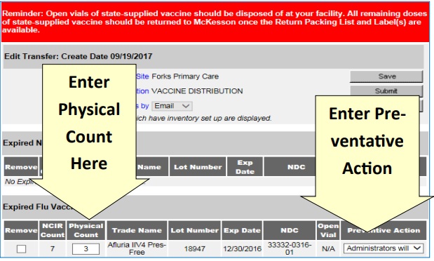
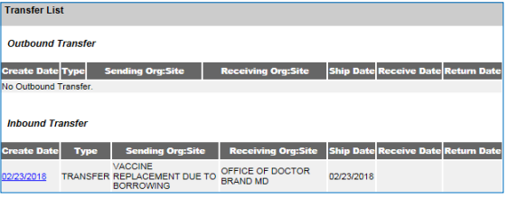
How to Report and Return Expired State-Supplied Vaccine
Click ‘Manage Transfers’.
Click ‘New Transfer’.
Click ‘Transfer All Expired’.
Verify the physical count. If the number of doses being returned is incorrect, enter the number of doses being returned even if it does not match NCIR’s estimate. NOTE: The difference in physical and digital inventory is recorded as unaccounted vaccine.
Click ‘Save’. You should see a “Saved Successfully” message.
You must generate either a packing list or label to complete the transfer.
Click ‘Ship’. Enter a Ship Date. Click ‘Ship’ again to complete the transfer.
You will see “Transfer Successfully Shipped,” and the transfer should appear in your Outbound Transfer list and include a date.
Source: https://immunization.dph.ncdhhs.gov/providers/ncir/pdf/NCIR_Quick_Reference_guide.pdf

Slide 33
Recalled Doses of VAXNEUVANCE ™
Merck has issued an expanded recall of 10 lots of VAXNEUVANCE™ (NDC# 00006-4329-03). This recall is due to a higher-than-expected number of customer reports of breakage at the syringe flange and/or hub.
If you received the recall notice, please carefully examine your inventory and immediately quarantine and discontinue use of the recalled doses.
Click here to read the DHHS communication on recalled doses of VAXNEUVANCE™ sent on January 17, 2024.

Slide 34
2024 Child, Adolescent and Adult Immunization Schedule
The 2024 Child and Adolescent Immunization Schedule includes new recommendations for:
respiratory syncytial virus (RSV) vaccine
respiratory syncytial virus (RSV) monoclonal antibody
mpox vaccine
20-valent pneumococcal conjugate vaccine
pentavalent meningococcal vaccine
The 2024 Adult Immunization Schedule includes new recommendations for:
respiratory syncytial virus (RSV) vaccine
mpox vaccine
pentavalent meningococcal vaccine
Both schedules also include updated recommendations for 2023-2024 formula COVID-19 vaccine, influenza vaccines, and inactivated poliovirus vaccine (IPV).
MMWR has published two reports summarizing 2024 updates to CDC Immunization Schedules:
Advisory Committee on Immunization Practices Recommended Immunization Schedule for Children and Adolescents Aged 18 Years or Younger —United States, 2024
Advisory Committee on Immunization Practices Recommended Immunization Schedule for Adults Aged 19 Years or Older—United States, 2024
NCIP Coverage Criteria has also been updated! Check it out here.

Slide 35
Polio Vaccine Available for Adult Populations Displaced from Ukraine
The North Carolina Immunization Program (NCIP) received federal funding from the Centers for Disease Control and Prevention (CDC)to support the purchase IPOL® poliovirus vaccine to be administered to displaced Ukrainians. This provides a one-time opportunity for local health departments to request polio vaccines. The doses may only be administered to adults displaced from Ukraine. A survey was set up to let DHHS know how many polio doses are needed by LHDs to serve the displaced Ukrainian population in 2024. The survey closed on Thursday, January 18, 2024 at 9am. Do not order via NCIR. Vaccines have not yet been shipped to the LHDs who requested doses. NCIP is working on the procurement logistics.

Slide 36
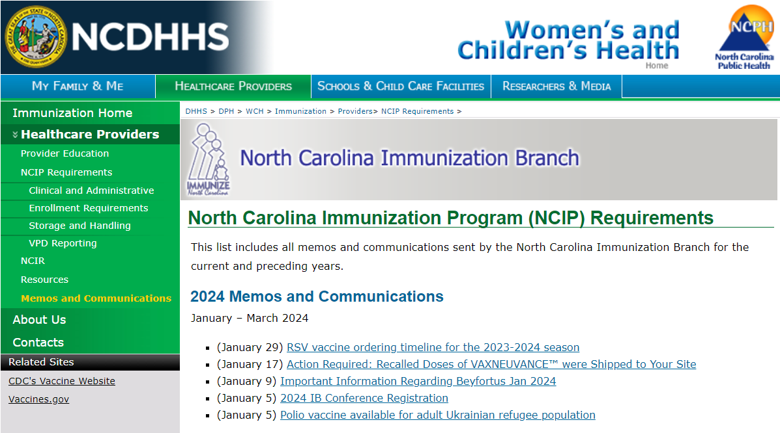
Where to Find DHHS Memos & Communications
Reminder: You can now find DHHS Immunization Branch memos and communications here.

Slide 37
COVID-19 Vaccine Updates

Slide 38
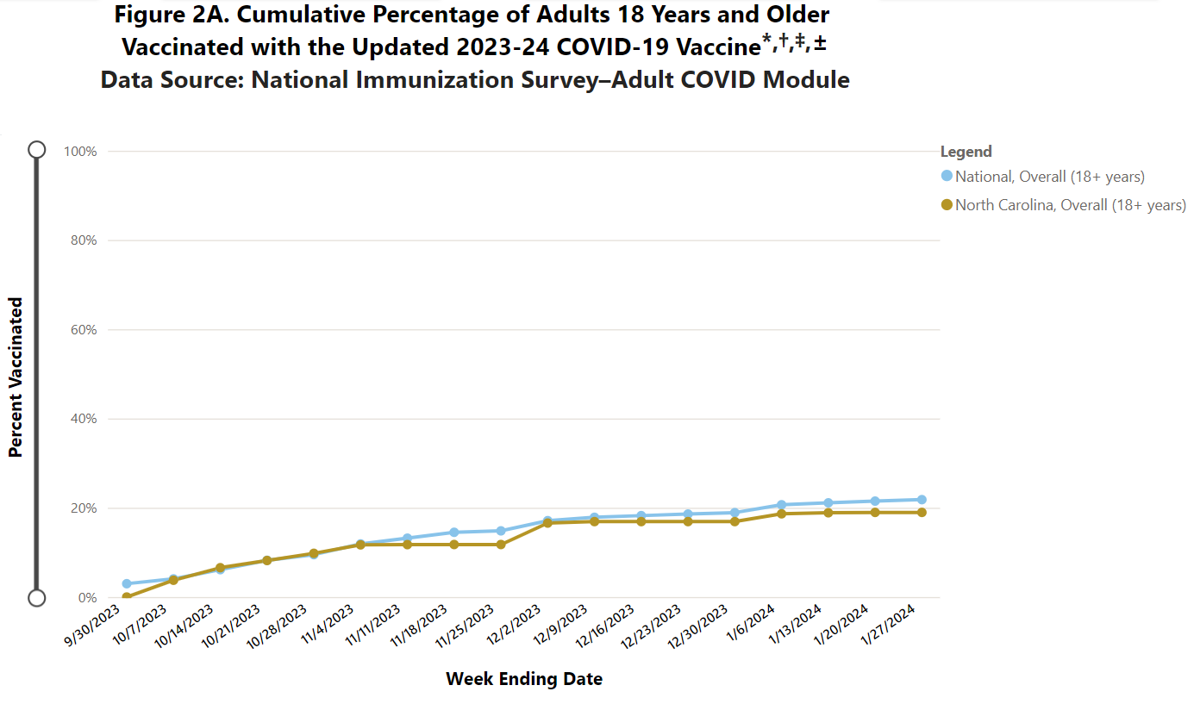
​COVID-19 Vaccination Coverage in North Carolina and US: Adults
National: 21.8% North Carolina: 19%
Source: https://www.cdc.gov/vaccines/imz-managers/coverage/covidvaxview/interactive/adult-coverage-vaccination.html

Slide 39
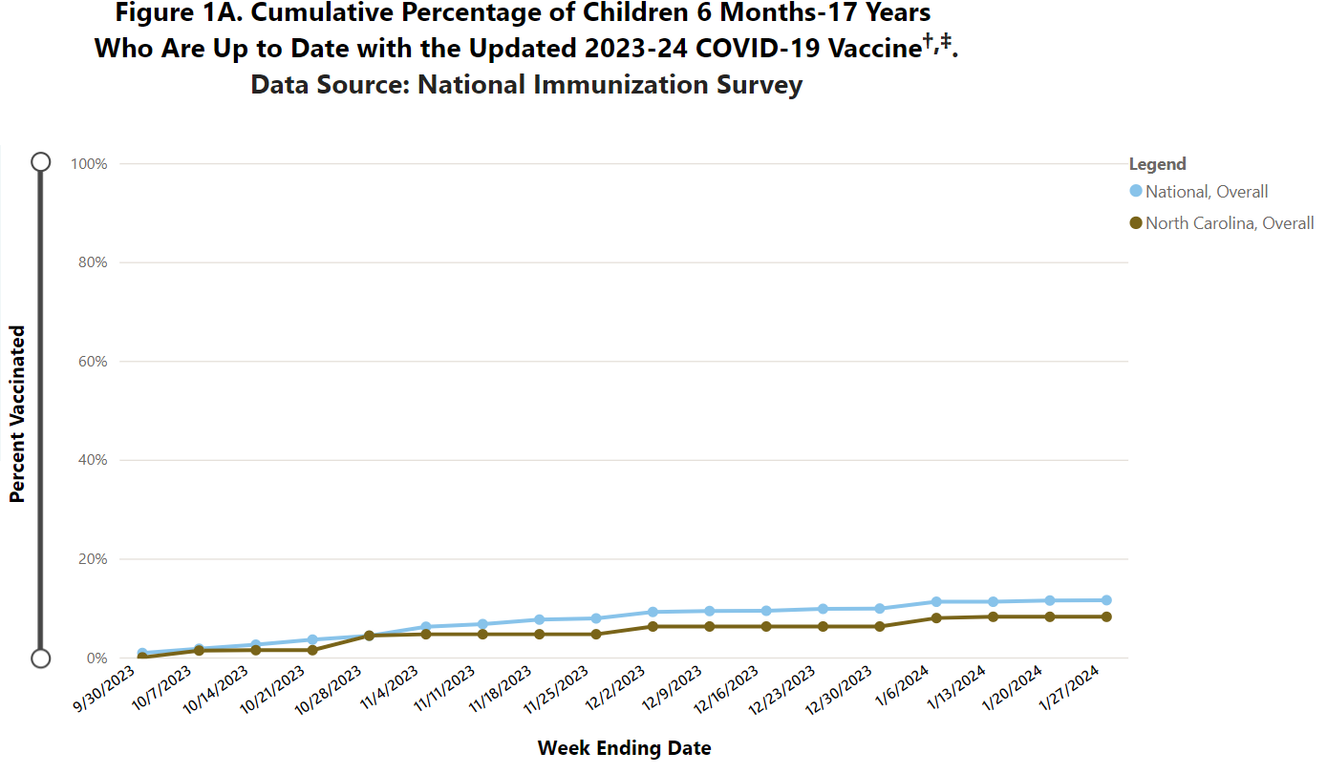
​COVID-19 Vaccination Coverage in NC and US: Children 6 months – 17 years
National: 11.6% North Carolina: 8.2%
Source: https://www.cdc.gov/vaccines/imz-managers/coverage/covidvaxview/interactive/children-coverage-vaccination.html

Slide 40
Purchasing COVID-19 vaccine for insured patients
Manufacturer | Instructions
Moderna | Order via McKesson, Cardinal or AmeriSource Bergen distributors or directly via Moderna at modernadirect.com or 1.866.663.3762.
Pfizer | Order via wholesalers or directly via Pfizer at primecontracts.Pfizer.com at or 1.800.666.7248.
Novavax | Order via dedicated distributor. Contact Courtney Goober: Cgoober@Novavax.com
Remember:
VFC providers are required to stock and offer VFC doses for VFC eligible children.
VFC providers are required to meet the private inventory requirement for COVID-19 vaccines no later than March 31, 2024 (based on patient population). Minimum ordering quantity can be used.

Slide 41
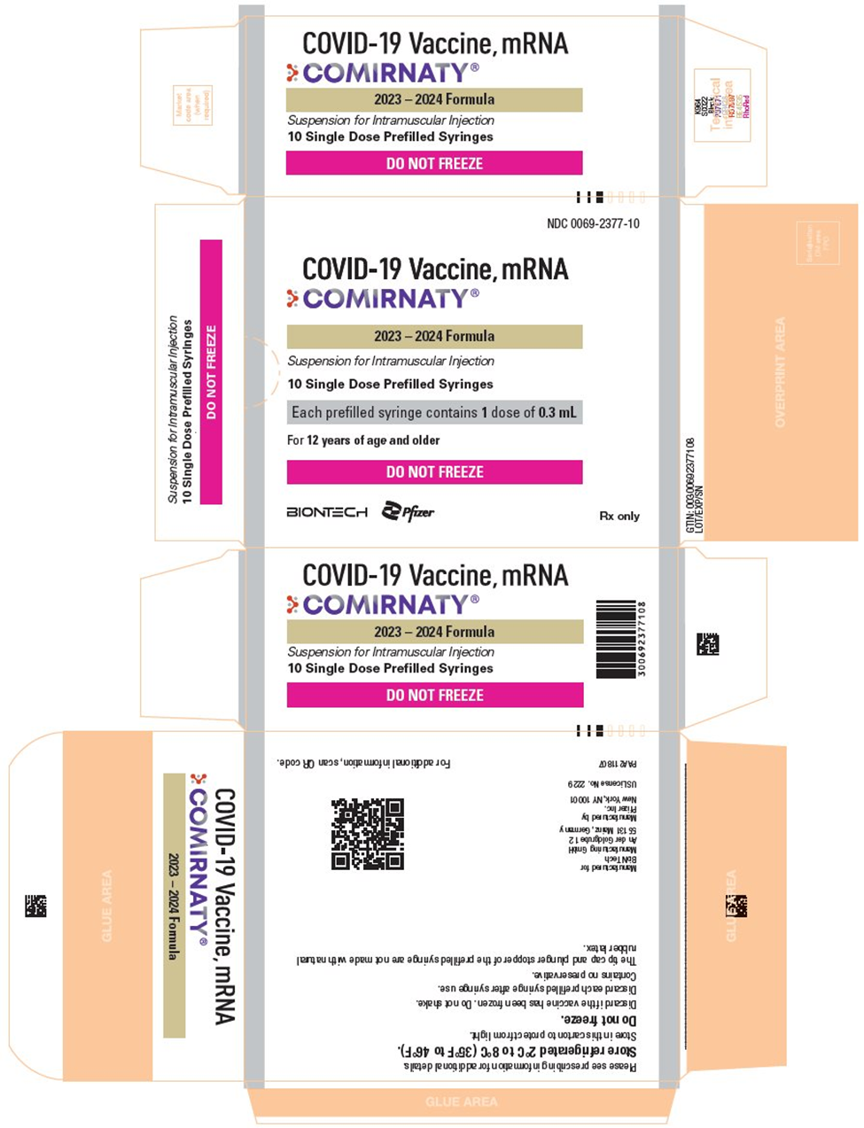
New Presentation for Pfizer 12+ Vaccines
CDC has begun replacing the current Pfizer 12y+ vaccine supply with Pfizer’s new refrigerated 12y+ vaccine (NDC 00069-2377-10), a new presentation in a carton of 10 manufacturer-filled syringes (MFS).
This new presentation MUST BE STORED BETWEEN 2°C and 8°C (36°F and 46°F). Do NOT store at ultra-cold or standard freezer temperatures.
These manufacturer-filled syringes can be used through the expiration date printed on the carton. The 10-week beyond-use date (BUD) for refrigerator storage does not apply.
This guidance applies to this presentation ONLY. Pfizer-BioNTech COVID-19 vaccines for children aged 6m-4y and 5-11y, which are shipped to providers in CDC’s programs directly from Pfizer on dry ice and can be stored at either at ultracold temperatures until expiry or up to 10 weeks at 2-8C.
Providers who have the original Pfizer 12y+ vaccine on hand can and should continue to use this product until it is consumed, expired, or has been stored at 2-8C for longer than the allowable 10 weeks.
Notes:
Of note: Pfizer will continue to allow providers to privately order the original manufacturer-filled syringes for age 12+. Therefore, providers may have BOTH presentations – MFS with a 10-week BUD and MFS that can be used through the expiration date- in their storage units. If this occurs, encourage providers to educate staff on the different storage requirements and strategies to prevent potential errors. CDC COVID-19 clinical materials are being updated to include this new presentation and storage guidance.

Slide 42
Updated Statewide Standing Orders (January 22, 2024)
Product | Updates
Novavax Pfizer-BioNTech (6m-11y) COMIRNATY (Pfizer, 12+) Moderna (6m-11y) SPIKEVAX (Moderna, 12+) | Session Law 2023-65, Sec. 9G.7 (to extend authorization through December 31, 2024) added. Links to CDC's Screening Checklist for Contraindications and COVID-19 vaccines listed for emergency use by the World Health Organization (WHO) were updated.
COMIRNATY (Pfizer, 12+) | VIS added; New presentation added with storage information (glass pre-filled syringes, fridge storage only)
SPIKEVAX (Moderna, 12+) | VIS added

Slide 43
Last fall, V-safe added functionality to allow pregnant people 32–36 weeks pregnant and adults aged 60 and older who received an RSV vaccine to register for V-safe. Updated COVID-19 vaccines are now included.
You can promote V-safe to your patients by including information about V-safe in the educational materials you provide to patients when they receive an RSV or updated COVID-19 vaccine. Below are a few ways you can help:
Include this V-safe info sheet to vaccine recipients at the time of receipt of an RSV and/or COVID-19 vaccine.
Hang V-safe posters in waiting areas and other places that vaccine recipients can easily view.
Encourage RSV and COVID-19 vaccine recipients to sign up for V-safe at Login (cdc.gov).
Visit and share the V-safe webpage for information and resources.
Vaccine safety monitoring is a top priority at CDC. V-safe is one of several systems the CDC uses to closely monitor the safety of vaccines in the US. The information gathered through V-safe helps CDC communicate timely and transparent information about the safety of vaccines to public health officials, healthcare providers and the public.
CDC’s V-safe now includes 2023-2024 updated COVID-19 vaccines

Slide 44
Resources
CDC’s Interim Clinical Considerations for Use of COVID-19 Vaccines in the United States
Updated COVID-19 Vaccine Statewide Standing Orders
NC DHHS COVID-19 FAQs

Slide 45
Flu Updates
Flu activity remains elevated nationally with increases in some parts of the country.
Nationally, percent positivity for influenza overall remained stable. However, percent positivity for influenza A decreased slightly and percent positivity for influenza B increased slightly.
Outpatient respiratory illness has been above baseline nationally since November and is above baseline across the US.
The number of weekly flu hospital admissions decreased slightly compared to last week.
On December 14, 2023, CDC published a HAN (Health Alert Network) Health Advisory to alert healthcare providers to low vaccination rates against flu, COVID-19, and RSV (respiratory syncytial virus).
CDC recommends that everyone 6 months and older get an annual flu vaccine as long as influenza viruses are spreading. Vaccination now can still provide benefit this season.
Find current flu information here.

Slide 46
Please continue to order and administer nirsevimab (Beyfortus™) for infants and young children through March 31, 2024, in accordance with the Advisory Committee on Immunization Practices (ACIP) recommendations.
If you have extra VFC doses you will not be able to use by March 31, please complete this survey to offer your doses to providers who may be able to utilize them. NC Immunization Program (NCIP) will help redistribute your vaccine.
After March 31, any unexpired remaining doses should be labeled "DO NOT USE" and stored under appropriate storage conditions until the start of next respiratory season, October 1, 2024.
ABRYSVO™ for pregnant people may no longer be ordered or administered for this season as of January 31, 2024.
RSV Vaccine Ordering Dates

Slide 47
Seasonal Administration of RSV Vaccine*
January 31, 2024
Seasonal administration of maternal RSV vaccine is only recommended through the end of January in NC.
March 31, 2024
Infants born to unvaccinated mothers during RSV season should receive nirsevimab through the end of March (i.e., February 1 – March 31).
*For more information, see the COCA alert dated January 26, 2024.

Slide 48
Q: If a dose of maternal RSV vaccine is inadvertently administered after January 31, is it considered valid?
Yes, even if vaccination occurs after January 31*, the dose is considered valid. Nirsevimab is not recommended for the infant after they are born. Either maternal RSV vaccination during pregnancy or nirsevimab administration to the infant is recommended to prevent RSV-associated LRTI in infants, but both are not needed for most infants.
All vaccine administration errors should be reported to Vaccine Adverse Event Reporting System (VAERS), even if the administration did not result in an adverse event.
Please note, insurance might not cover administrations given outside of the ACIP recommended September through January timeframe.

Slide 49
How to Obtain ABRYSVO™
Local Pfizer pharmaceutical representative or vaccine wholesaler
Pfizer Customer Service 1-800-666-7248
Vaccines for Children Program (VFC) for VFC eligible* pregnant adolescents
*A child is eligible for the VFC Program if he or she is younger than 19 years of age and is one of the following: Medicaid-eligible, uninsured, underinsured (at FQHCs, LHDs, and deputized provider locations), American Indian or Alaska Native.
Notes:
Here’s how you can obtain ABRYSVO… You can go through your typical vaccine procurement process using your local Pfizer pharmaceutical rep or contact Pfizer directly using the number noted on the slide. The vaccine will also be available (hopefully starting this month) for providers enrolled in the Vaccines for Children program, but those doses can only be administered to pregnant adolescents under the age of 19 who are VFC eligible (meaning, they must have Medicaid, no insurance, be underinsured, or American Indian or Alaska Native. If you are a local health department attending this call, please pay particular attention to this information as those ages 19 and older as well as fully insured adolescents will not be able to receive state supplied doses. You must procure private stock for these individuals. While we have been able to supply a small number of vaccines for uninsured, pregnant women seeking care at a local health department or FQHC, ABRYSVO is not one of these.

Slide 50
Mpox Updates
Vaccines (e.g., JYNNEOS, ACAM2000) and other medical countermeasures are available and expected to be effective for both Clade I and Clade II MPXV infections. However, vaccination coverage in the US remains low, with only one in four people who are eligible to receive the vaccine having received both doses of JYNNEOS. CDC recommends that clinicians encourage vaccination for patients who are eligible, which includes:
Anyone who has or may have multiple or anonymous sex partners
Anyone whose sex partners are eligible per the criteria above
People who know or suspect they have been exposed to mpox in the last 14 days
Anyone who considers themselves at risk for mpox through sex or intimate contact
Mpox metrics in North Carolina: MPOX | NCDHHS
Click here to read the DHHS communication on mpox infections sent December 29, 2023.
Notes:
Adding for context: a clade is a broad grouping of viruses that has evolved over decades and is a genetic and clinically distinct group

Slide 51
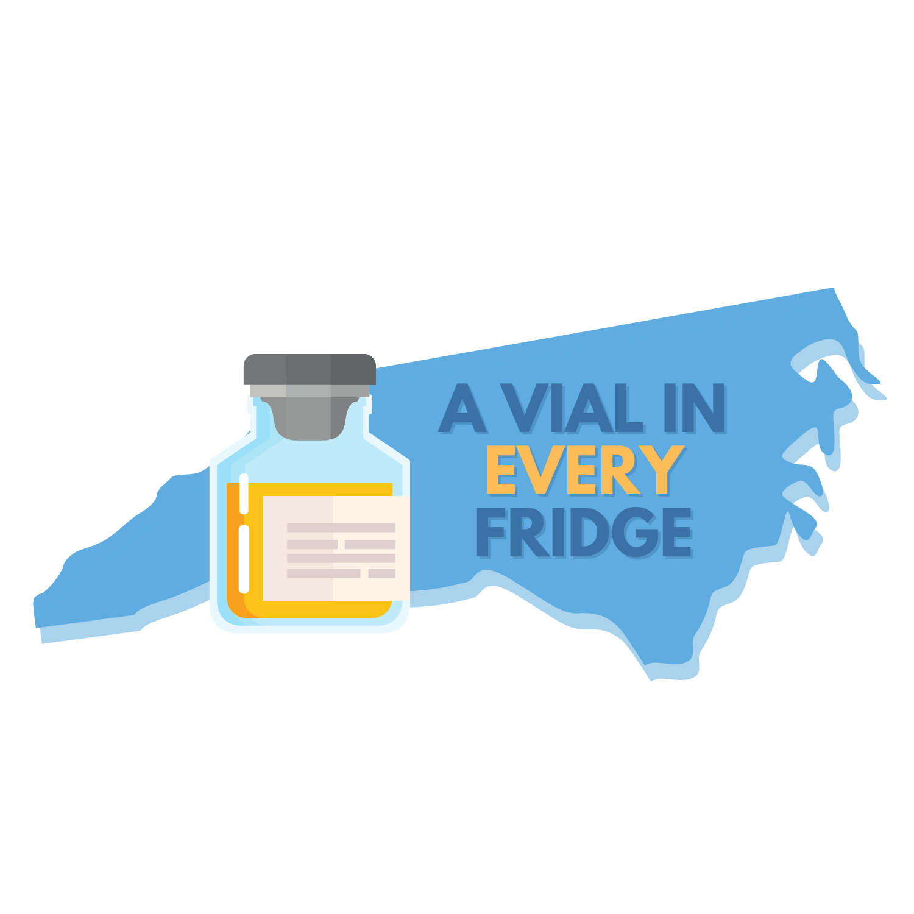
JYNNEOS: Ordering and New Provider Instructions
Providers who are interested in offering the mpox vaccine should begin by completing this survey.
Newly enrolled JYNNEOS providers can request vaccines here, or by contacting Kandice Oakley at kandice.oakley@dhhs.nc.gov to place an order.
The roadmap to becoming a JYNNEOS provider can be found here.
Our goal is to ensure there is a vial in every fridge and prevent missed opportunities.
Please reduce barriers by offering the vaccine in all adult clinics, not requiring prerequisites, etc.

Slide 52
Between December 1, 2023 and January 23, 2024, the CDC was notified of 23 confirmed US cases of measles. Most of these cases were among children and adolescents who had not received a measles-containing vaccine (MMR or MMRV), even if age eligible.
Providers should be on alert for patients who have:
febrile rash illness and symptoms consistent with measles (e.g., cough, coryza, or conjunctivitis), and
have recently traveled abroad, especially to countries with ongoing measles outbreaks.
The increased number of measles importations seen in recent weeks is reflective of a rise in global measles cases and a growing global threat from the disease.
People 6 months of age and older who will be traveling internationally should be protected against measles. CDC guidance on MMR vaccines can be found here.
For more information and resources, see the COCA alert sent 25 January 2024.
Measles: CDC COCA Update Jan 2024

Slide 53
NCIR Update
A new funding code, titled "Bridge", has been added to the NCIR to improve inventory management and vaccine tracking of COVID vaccine doses administered through the COVID Bridge Program.
Bridge providers should continue to document bridge doses under the already established Bridge Access subsites (if applicable) until further guidance is released.

Slide 54
Agenda
Opening Remarks | Stacie Turpin Saunders, MPH Deputy Director/Section Chief, Local and Community Support
Epi Section Update | Zack Moore, MD, MPH State Epidemiologist and Epidemiology Section Chief
MCU Update | Erica Wilson, MD, MPH Medical Director, Medical Consultation Unit
Measles; HPAI; cipro resistant NMn Update | Emma Doran, MD, MPH Medical Director, Vaccine Preventable and Respiratory Diseases
Syphilis Update | Vicki Mobley, MD, MPH Medical Director, HIV/STI
Wastewater Surveillance Update | Molly Deutsch-Feldman Environmental Health
Vaccine Update | Carrie Blanchard, PharmD, MPH Immunization Branch Interim Director
Therapeutics Update | Tim Davis, PharmD, PMP Medical Countermeasures Coordinator
Question & Answer Session | Open for Questions — Please use the Zoom Q&A function

Slide 55
COVID-19 Testing and Therapeutics Updates
Tim Davis, PharmD
Medical Countermeasures Coordinator
North Carolina Public Health Preparedness and Response

Slide 56
Covid treatments Lagevrio and Paxlovid now commercially available
Update to Paxlovid Emergency Use Authorization (EUA)
The FDA has updated the Paxlovid EUA letter of authorization, stating that EUA-labeled Paxlovid distributed by the U.S. Government will remain authorized for use only through March 8th, 2024 regardless of labeled or extended expiration date.
EUA Paxlovid return deadline extended to February 29, 2024
Every EUA course returned = 1 course credit for USG Patient Assistance Program
Providers should initiate returns now to ensure receipt before the deadline
www.paxlovidEUAreturns.com; paxlovidEUAreturns@inmar.com; 1-877-740-6148
To avoid supply chain issues, we strongly encourage pharmacies and providers to purchase commercial Paxlovid now, if they have not done so already

Slide 57
Oral antiviral patient support programs
Patient Support Programs are available to ensure continued affordable access to COVID treatment post-commercialization
Pfizer’s patient support program for Paxlovid, called PAXCESS, provides:
A Co-pay assistance program for commercially insured individuals
A Patient Assistance Program for uninsured, Medicare, Medicaid, TRICARE, and VA Community Care Network Plans
Ways to access and enroll:
Patients and Caregivers – PAXLOVID.com or 1-877-C19-PACK
HCPs and Pharmacists – PAXLOVID.Pfizerpro.com or 1-877-C19-PACK
Merk’s patient support program for Lagevrio
For individuals, primarily the uninsured, who without assistance could not afford the product
HCPs call 1-800-727-5400 and make an “Urgent Need” request
Visit MerkHelps.com/LAGEVRIO for more information or to check eligibility

Slide 58
Order Free at-home COVID Test kits
For Health Departments, Long Term Care Facilities, Community Organizations, etc:
Bulk COVID test ordering available through Federal Test Distribution Program
Order directly in Health Partner Order Portal (HPoP): https://hpop.hhs.gov
Sites without an existing HPoP account can fill out our HPoP Registration Form or email covid19testingandtreatments@dhhs.nc.gov
For Individuals:
USPS Test Kit Distribution: www.covid.gov/tests - Up to 8 tests per household
Find a Community Access Point near you: https://covid19.ncdhhs.gov/PickUpHomeTests
Check your inventory! After checking for extended expiration dates online, dispose of expired tests and order more.
Notes:
-over 280 CAP sites across 93 counties still available for free at-home test pick-up

Slide 59
COVID-19 Test Order Process via the Health Partner Order Portal (HPoP)
UPDATED: 01/2024
To order and receive shipments, partners must have an active account within HPoP. Click here to register if you do not have an active HPoP account.
Every Monday by 11:59 PM
Tuesday
Wednesday
Orders typically arrive 7-10 days from the shipping date.
Submit test order
Order Review
Order transmission
Orders delivered
Orders must be submitted in HPoP by Monday at 11:59 PM to receive a shipment that week
NC DHHS will review, validate and process orders
On Wednesdays at 9:30 AM, all orders will be transmitted from ASPR to distribution partners for processing
How to Submit a Test Order:
Sign in at https://hpop.hhs.gov
Navigate to Site Orders/Inventory.
Make sure you are in the Orders tab.
Click Create Order in the top right corner of the screen.
Select COVID-19/Diagnostic.
Select the Test Brand you wish to order.
Select the Quantity.
Review your order.
Once you have reviewed your order and are ready to proceed, click Submit Order.
Available COVID-19 Tests:
**NEW**
Orasure InteliSwab (2 ct) Min: 1 package/48 tests Max: 1,000 packages/48,000 tests | SD Biosensors Inc. Pilot (4 ct) Min: 1 package/612 tests Max: 1,000 packages/612,000 tests
If you are experiencing any issues or need further assistance, please email covid19testingandtreatments@dhhs.nc.gov

Slide 60
national telehealth program for COVID and FLU testing and treatment
The National Home Test to Treat Program now includes access to free COVID and flu at-home tests and telehealth care
Individuals who are uninsured or enrolled in Medicaid, Medicare, VA or Indian Health Services can enroll anytime to receive free at-home COVID-19/flu tests.
Anyone who tests positive for COVID-19 or flu, regardless of insurance status, can receive free telehealth care. Treatment, if prescribed, will be provided at no cost.
Individuals can sign up at https://www.test2treat.org/ or call 1-800-682-2829.
Help spread the word! Promotional flyers available here.

Slide 61
Agenda
Opening Remarks | Stacie Turpin Saunders, MPH Deputy Director/Section Chief, Local and Community Support
Epi Section Update | Zack Moore, MD, MPH State Epidemiologist and Epidemiology Section Chief
MCU Update | Erica Wilson, MD, MPH Medical Director, Medical Consultation Unit
Measles; HPAI; cipro resistant NMn Update | Emma Doran, MD, MPH Medical Director, Vaccine Preventable and Respiratory Diseases
Syphilis Update | Vicki Mobley, MD, MPH Medical Director, HIV/STI
Wastewater Surveillance Update | Molly Deutsch-Feldman Environmental Health
Vaccine Update | Carrie Blanchard, PharmD, MPH Immunization Branch Interim Director
Therapeutics Update | Tim Davis, PharmD, PMP Medical Countermeasures Coordinator
Question & Answer Session | Open for Questions — Please use the Zoom Q&A function

Slide 62
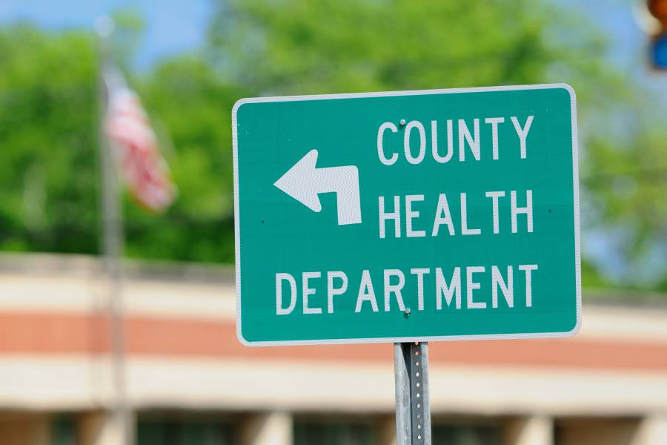
Q&A

